Slide 1
The Gunpowder Empires

Slide 2
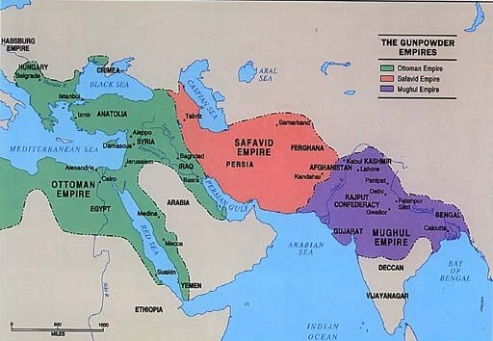

Slide 3
Ottoman Empire

Slide 5
Strengths of the Ottoman Empire

Slide 6
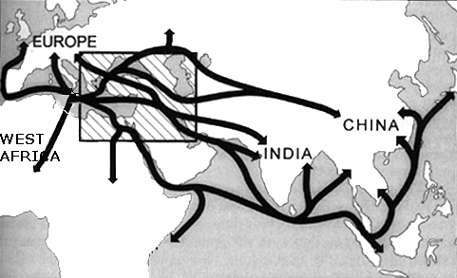
Control of Trade
  location
  control of waterways
Wealth from Trade
Superior Technology

Slide 7
Ottoman Characteristics

Slide 8
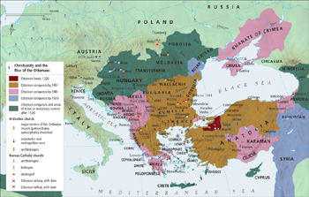
Position of Jews and Christians
Official Status
  “people of the book”
  given state protection (Ahl al-Dhimma)
  autonomy in religious affairs

Slide 9
Restrictions
  seen as inferior
  required to pay special tax (jiyzya)
  positions always subordinate to Muslims
  restrictions in dress
  social segregation

Slide 10
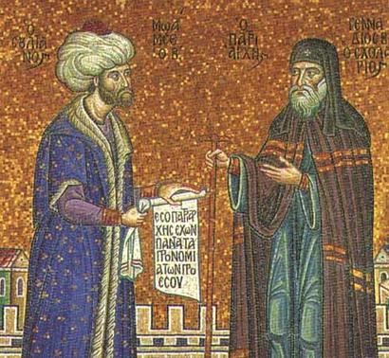
Millet System
  dealt with religious minorities as a community
  rabbi or priest acted as representative for entire community
  taxes paid as a community, not individually
  allowed for autonomy

Slide 11
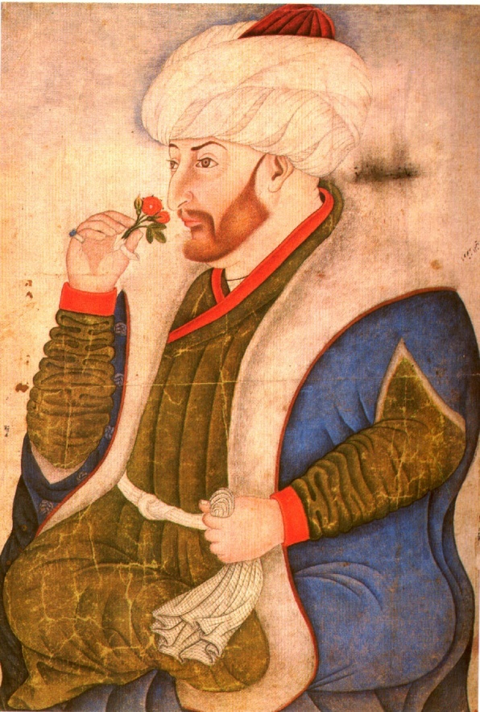
Mehmet II
captured Constantinople (1453)
made himself absolute sovereign
  total power

Slide 12
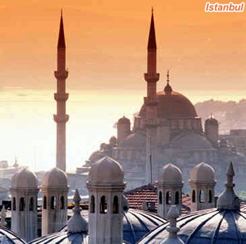
End of Byzantine Empire
  Muslims change European names
    Constantinople to Istanbul

Slide 13
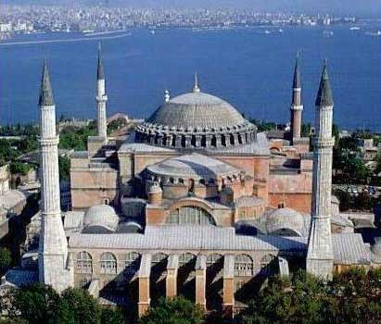
Hagia Sophia
  former church converted to mosque by Ottomans

Slide 14
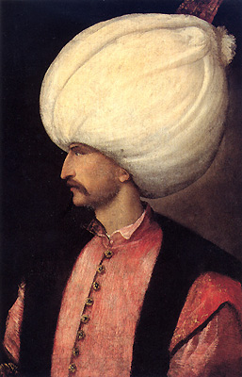
Suleiman the Magnificent (1520-1566)
peak of development (cultural, economic)
known as
  “the Magnificent” – b/c of splendors of his court
  kanuni – “law giver”
    combined Ottoman and Islamic legal codes

Slide 15
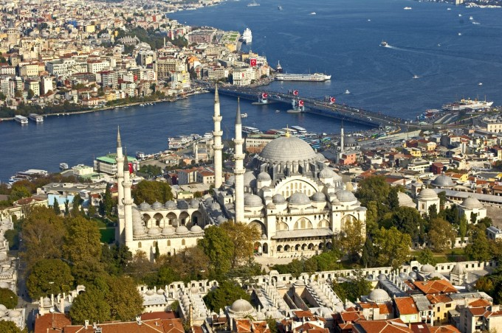
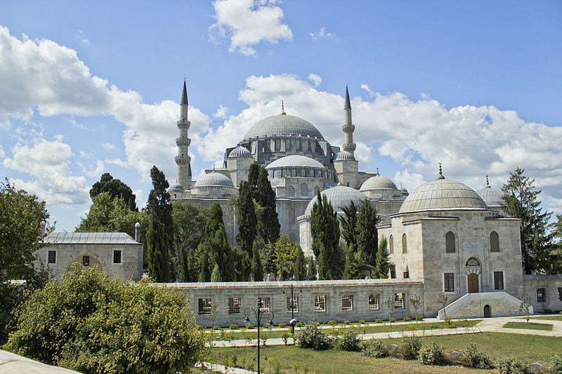

Slide 16
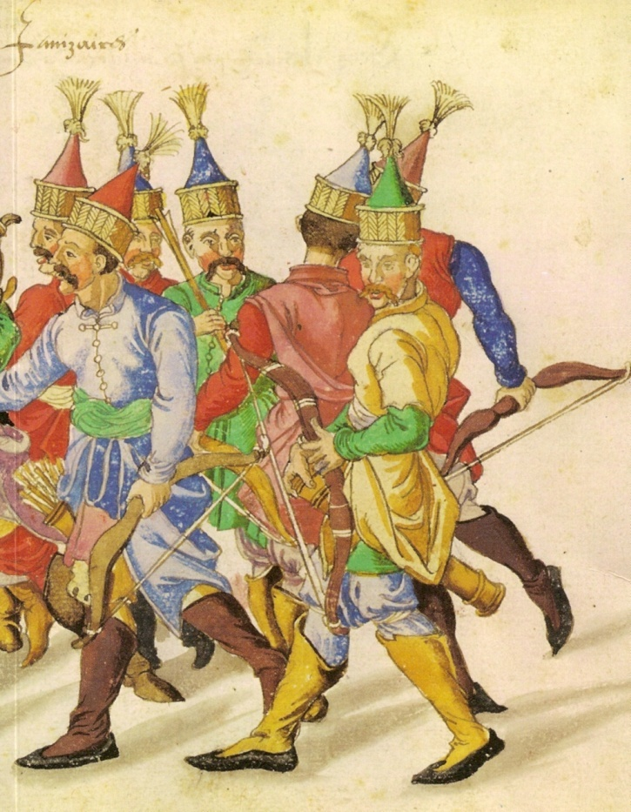
Janissaries
infantry units
formed sultan’s household troops

Slide 17
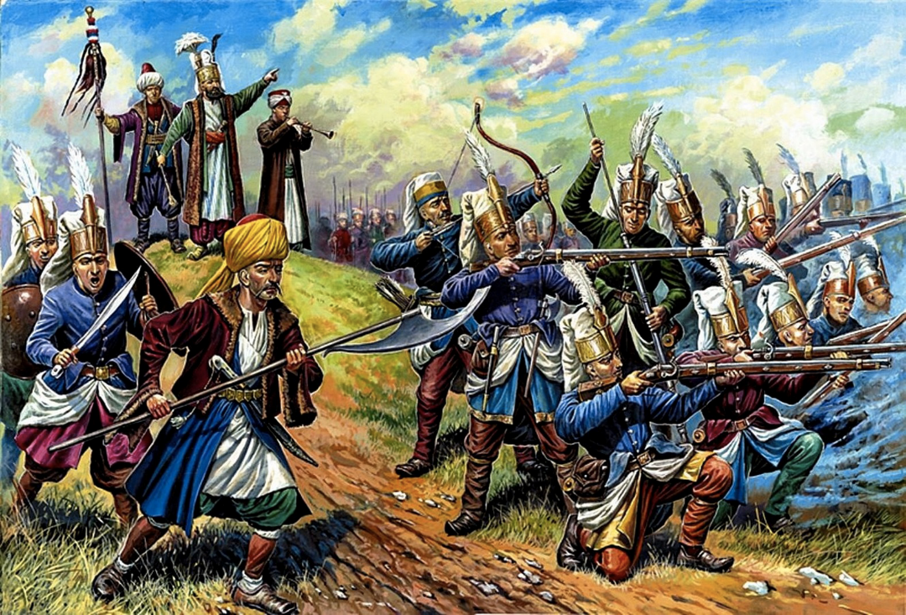
Background
  Sultan’s consideration of human captives as spoils of war
  captives became elite slave-soldiers

Slide 18
As time goes on, less land to conquer = less captives
plan changes to breed and train children to become these slave soldiers
devsirme system
  system of kidnapping children for military service

Slide 19
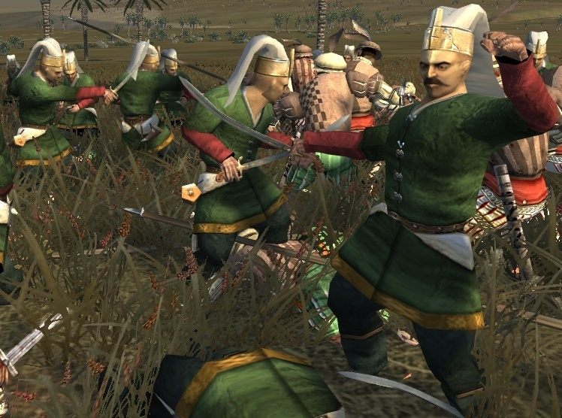
Criteria for selection
  strong but untrained
  good attitude, not spoiled
  no orphans or only sons
  handsome

Slide 20
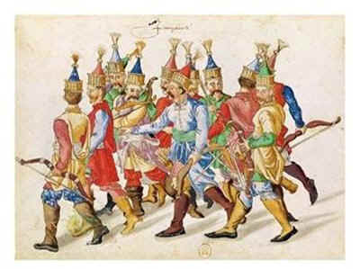
Training
  3-7 years
  conversion to Islam
  those that excelled
    serve as Sultan’s private army
  those that didn’t
    sere gov’t officials, work in fields

Slide 21
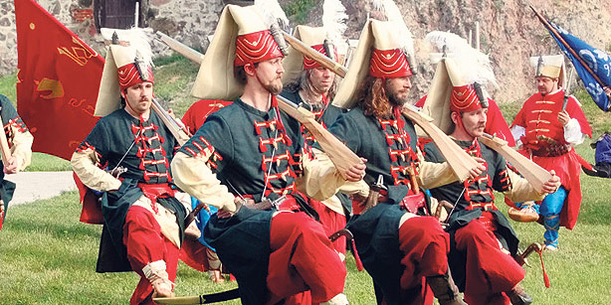
Expectations
  loyalty to Sultan and Islam
  obedience
  celibacy

Slide 22
Prospects
  upward mobility
  elite education
  high administrative position
  better than what they would have at home
    some Christians attempted to bribe officials to take their sons

Slide 24
The Safavid Empire

Slide 25
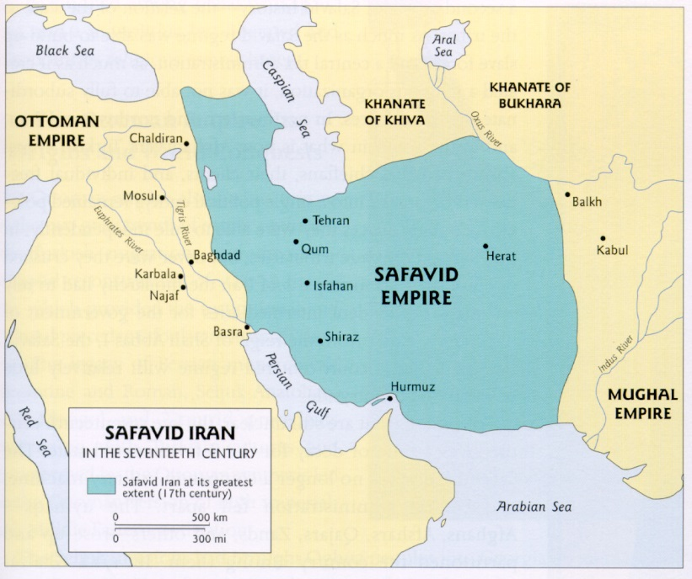
Characteristics
present day Iran
Shi’a Islam
land based empire
no navy, Europe controlled coast

Slide 26
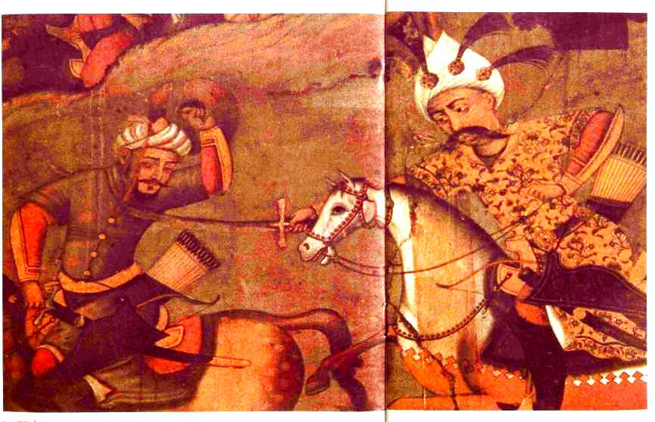
Attempt at Expansion
Battle of Chaldiran (1514)
  battle of ideals
  Safavids routed, but Ottomans can’t finish the job

Slide 27
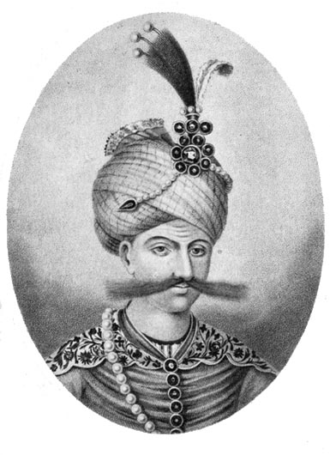
Abbas the Great (1588-1629)
revived glory of ancient Persia
force and diplomacy against Ottomans
alliances w/ European states

Slide 28
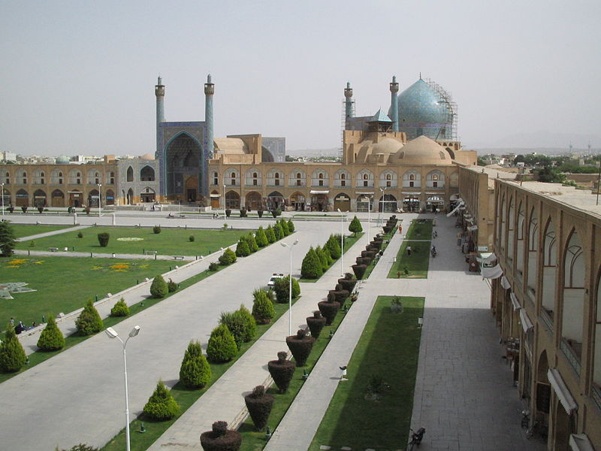
toleration for non-Muslims
new capital (Isfahan)

Slide 30
Isfahan v. Istanbul
Isfahan
Istanbul
inland city
few Europeans
little ethnic diversity
busy port city
colony of Europeans
cosmopolitan
women seldom seen in public

Slide 31
Decline
small/unproductive industry
little agricultural innovation
expense of firearms
warfare w/ Ottomans
inflation (cheap silver)
ends in 1722

Slide 32
Mughal Dynasty

Slide 33
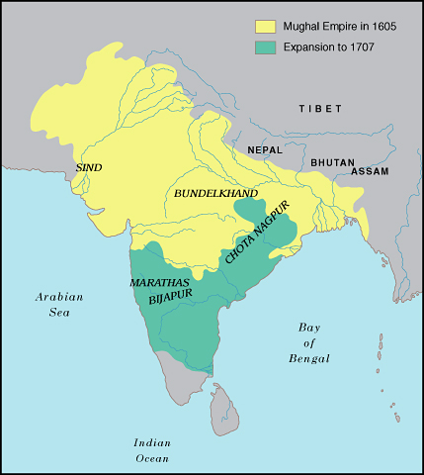

Slide 34
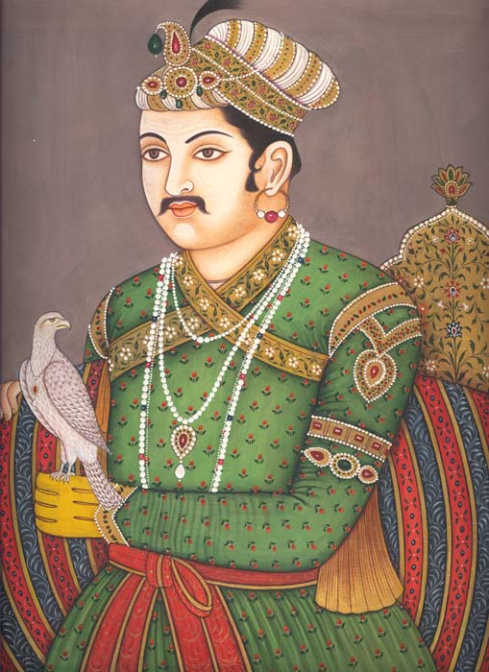
Expansion
Akbar
  combo of military and social policies

Slide 35
Most important- cooperation with Hindus
  intermarriage
  rid of jizya
  promotions in government
  new temples
  respect for cows

Slide 36
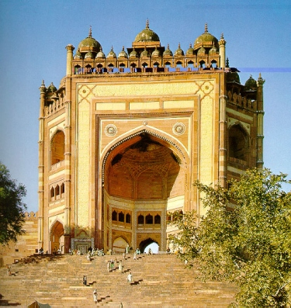
invents a new faith…Din-i-Ilahi

Slide 37
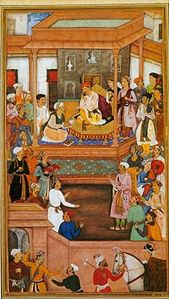
Social Reform
improves calendar
taking care of beggars
regulating alcohol

Slide 38
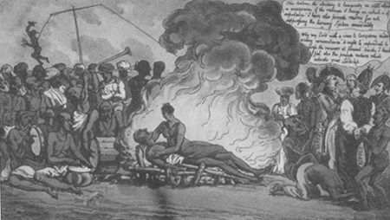
most visionary …women’s reforms
    remarriage for widows
    discouraged child marriages
    prohibited sati
    market days for women

Slide 39
Decline
no surprise…taxes, uprisings, overextension

