Slide 1
The Columbian Exchange

Slide 2
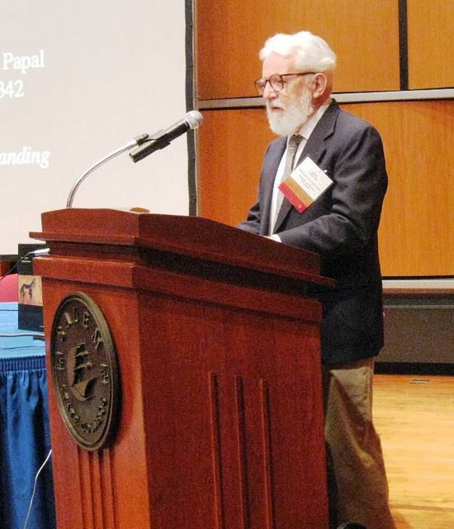
What is the Columbian Exchange?
“the contact between any two people geographically separated from one another results in an ‘exchange’ of physical elements.”
Alfred Crosby
Elements
Animals
Plants
Microbes

Slide 3
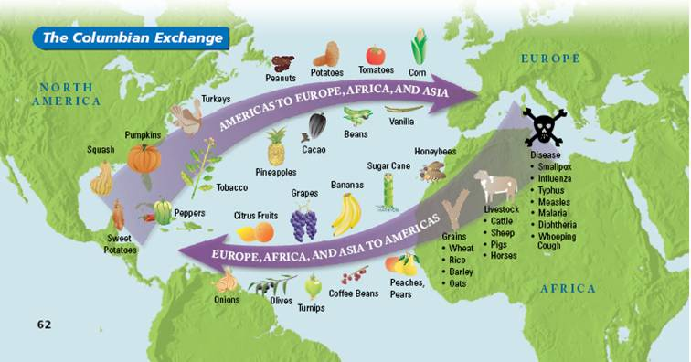
Notice the origins of the different items. Which 5 do you think had the most significant impact?

Slide 4
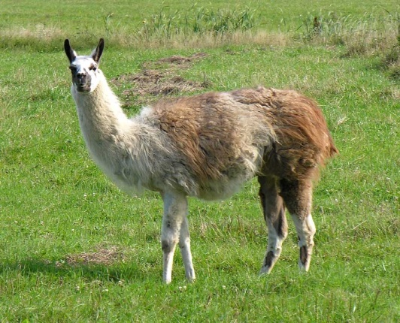
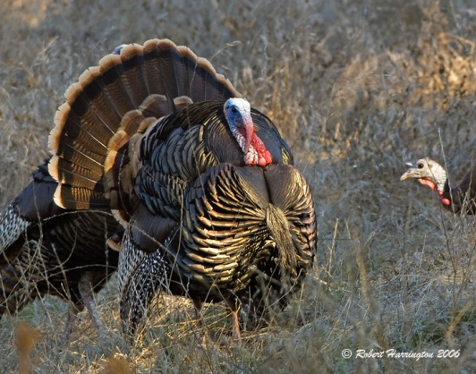
Animals
Domesticated pre-European arrival
Llama (South America)
Turkey (North America)
Europeans brought:
Cattle, chickens, horses, pigs

Slide 5
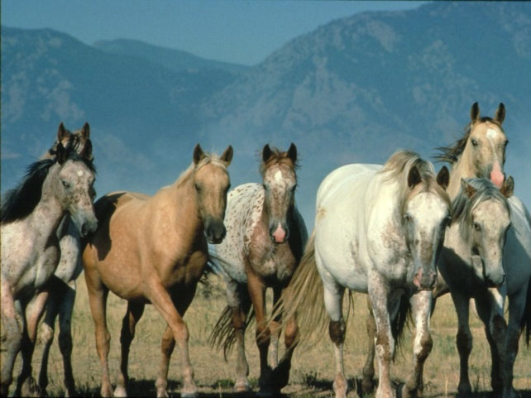
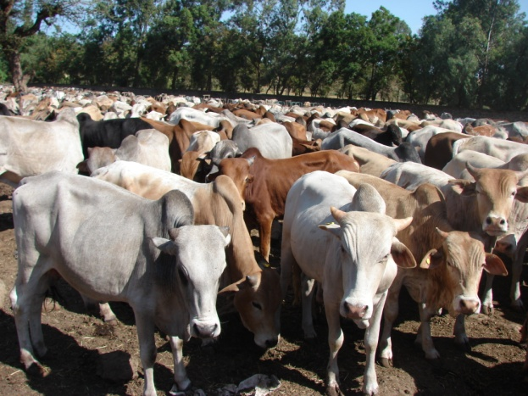
Effects
environmental impact
destroyed land with their hooves.
new forms of transportation and mobility in warfare
fertilizer

Slide 6
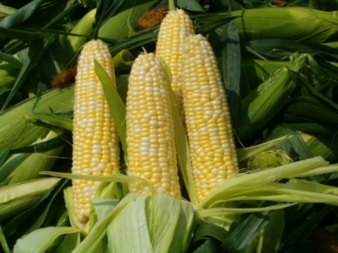
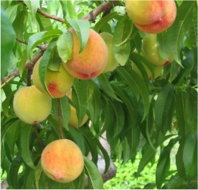
Plants
Europeans brought cash crops to the Americas and took new cash crops back.
To Europe:
Potatoes, tomatoes, corn
To the Americas:
Sugar, rice

Slide 7
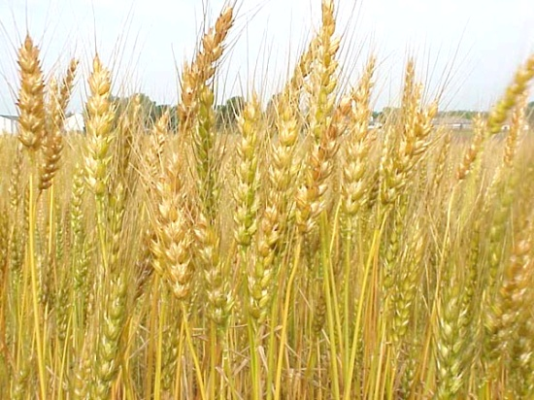
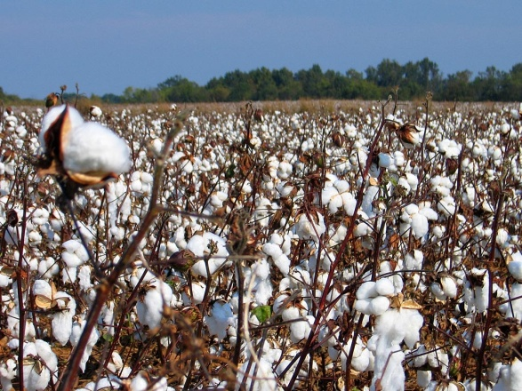
Effects
indigenous plants crowded out
old world crops were stronger.
large scale agricultural production.
labor intensive.
Europeans adopted crops from the Americas.
potato, tomato

Slide 8
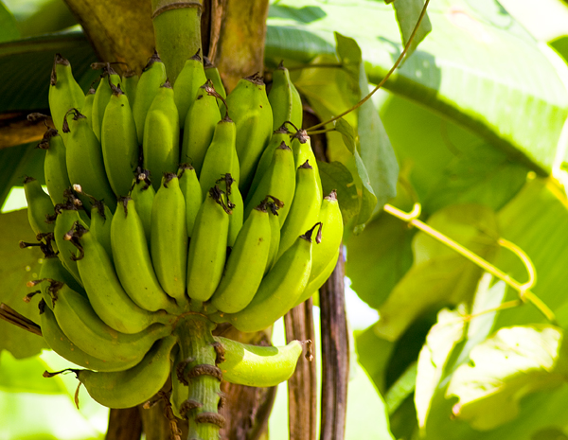
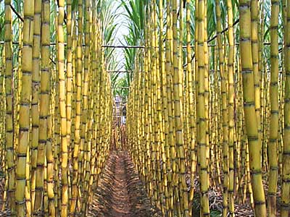
diversified American diets.
exploitation of labor
sugar cane
impact on Europe (potato, tomato)

Slide 9
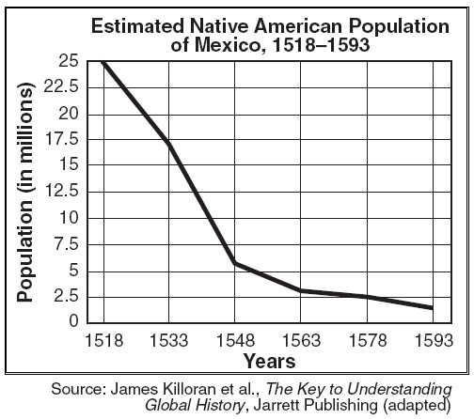
What does this graph show?
How can we explain this trend?
What were the repercussions (effects) of this de-population?

Slide 10
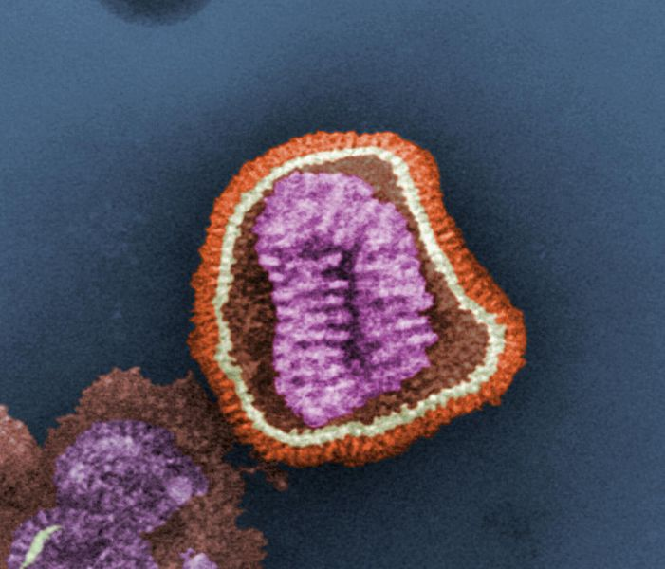
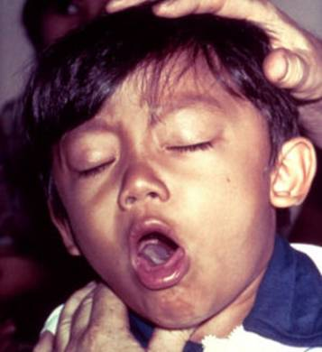
Disease
Smallpox, measles, diphtheria, whooping cough, chicken pox, bubonic plague, scarlet fever, and influenza.
communicable by air and touch.

Slide 11
European Beliefs regarding Disease
Illness in Europe was considered to be the consequence for sinning.
Native Americans were seen as “heathen” or non-Christian.
regarded as sinners and subjected to illness as a punishment.

Slide 12
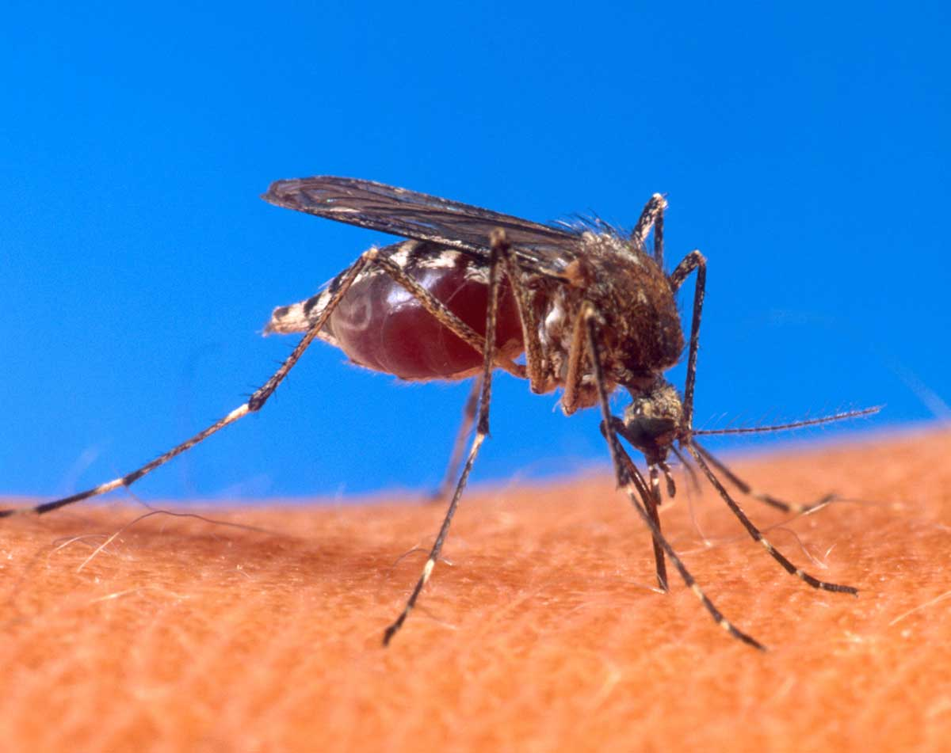
Why were Europeans Immune?
original environment, immunity
Europeans did bring home some American diseases such as syphilis.

Slide 13
Colonization

Slide 14
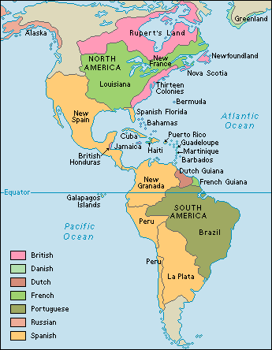
The Effects of the Europeans on the Americas

Slide 15
Spanish Colonies
With the Aztec and the Inca defeated, the Spanish began to set up colonies in the Americas
They created a new hierarchy:
The Spanish (Peninsulares): had the top jobs)
Creoles: Europeans born in the Americas
Mestizos and Mulattos: Those of mixed heritage-Spanish and Native or Spanish and African
Natives and Africans
Any remaining natives were controlled by the encomienda system

Slide 16
The Spanish Colonies
Led by Spanish officials called Viceroys
Greatly influenced by Catholicism
Mining precious metals was the basis of much of the economy

Slide 17
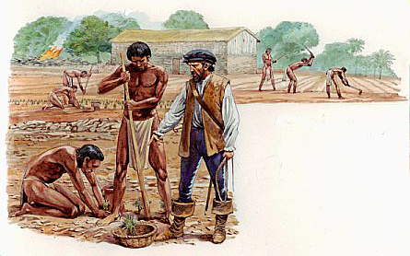
The Encomienda System
Right to force Native Americans to work
Resulted in major abuses of the Native Americans

Slide 18
The Importance of Sugar
Sugarcane was a valuable cash crop that grew well in the Americas
The labor was very difficult, so the Europeans forced Native Americans to work on the sugarcane plantations
Native Americans died from disease, warfare, and being overworked
The Europeans now needed someone else to work on the plantations-
but who?
Europeans begin importing Africans to work on their sugarcane plantations: this is the beginning of the trans-Atlantic slave trade

Slide 19
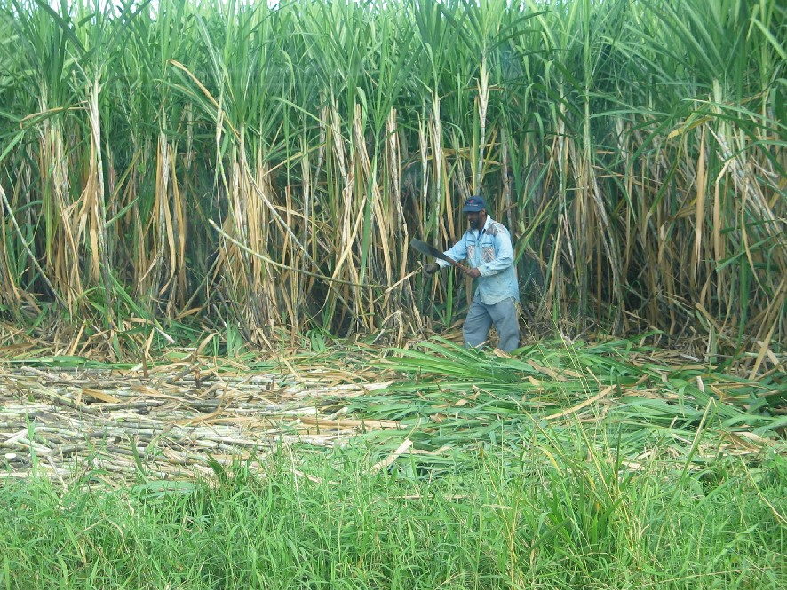

Slide 20
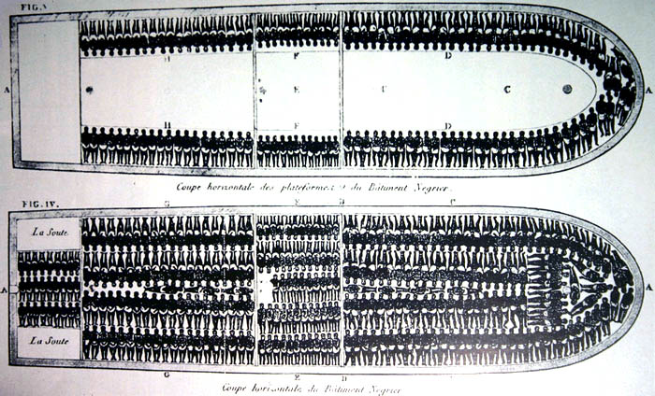
The Trans-Atlantic Slave Trade
In the early 1500s, Africans began to be sold in the Americas as slaves
Africans were immune to the diseases that had killed so many Native Americans
By the 1800s, 12 million people had been taken from Africa
Their journey from Africa to America was called the Middle Passage because it was the 2nd leg of a trade route known as the Triangular Trade

Slide 21
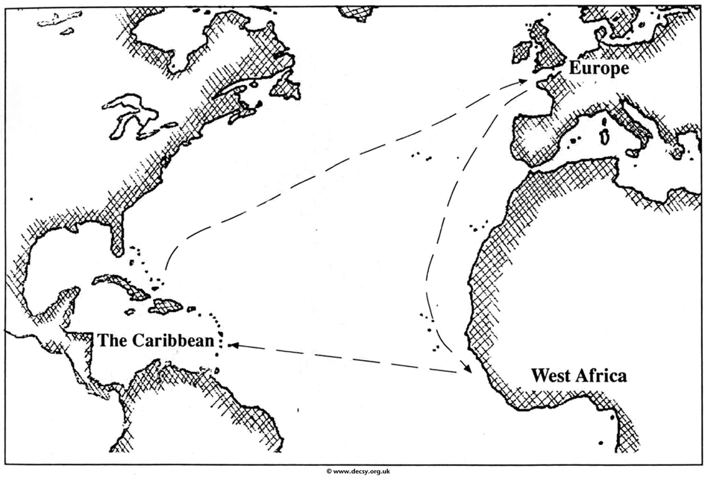
The Triangular Trade
Those that survived the horrific journey led a life of forced labor in the American colonies
Sugar,
tobacco,
cotton
The Middle
Passage
Rum, firearms, textiles
Slaves

Slide 22
Economic Results
Commercial Revolution
Europeans started using money rather than the barter system
This happened during exploration partly because of the vast amounts of gold and silver that started being sent to Europe
But what problem can arise if there is TOO much gold and silver?
INFLATION

Slide 23
Economic Results
Mercantilism
An economic theory that encouraged countries to
Acquire large amounts of gold and silver
So they could build a strong army and navy
Export more than they import
This was known as a “favorable balance of trade”
Conquer overseas colonies to get cheap raw materials
“Mother” countries in Europe can then use those materials to make goods to sell back to the colonies

Slide 24
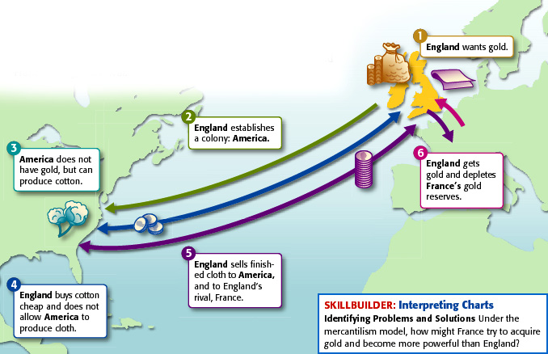

Slide 25
Economic Results
Joint Stock Companies
Groups of individual investors that pooled their money together to finance voyages of exploration
Positives Negatives

Slide 26
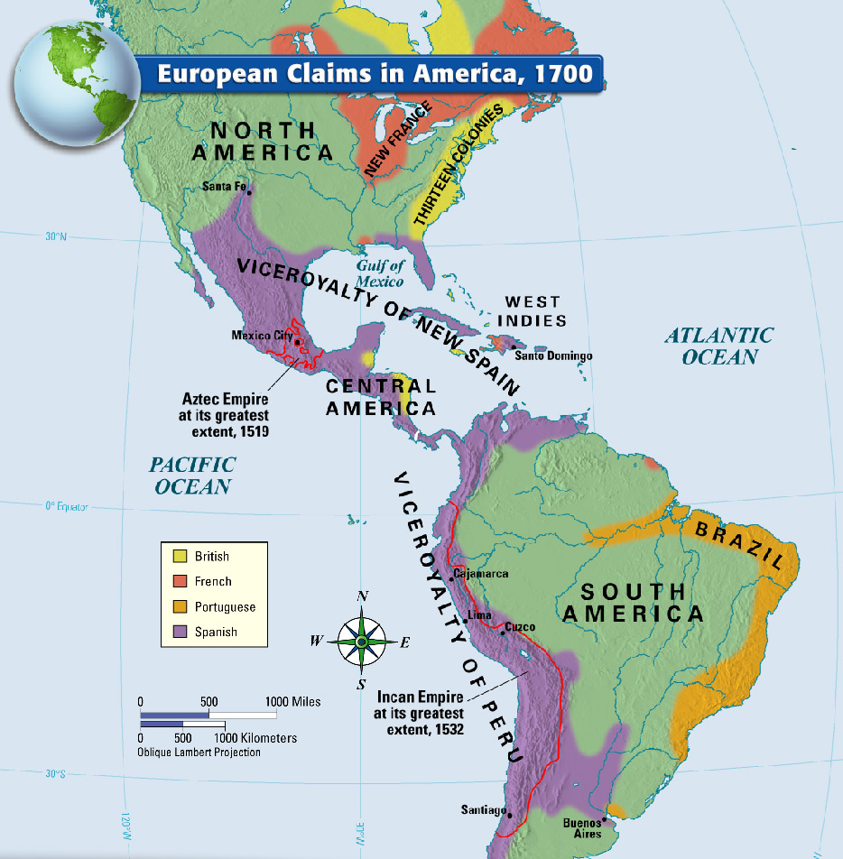

Slide 27
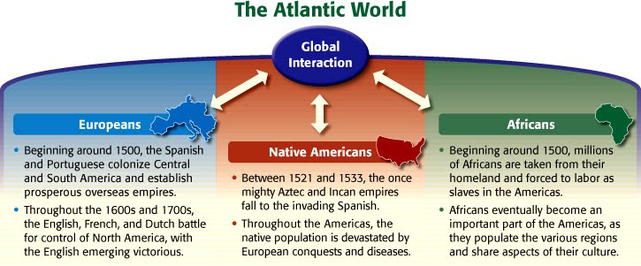

Slide 28
