Slide 1
Old v. New Imperialism Comparison
Period 5

Slide 2
In the nineteenth century …
___A British army faced a Sudanese army twice its size. The British won the battle, losing only 48 men while killing 10,000.
___Mountains of guano (bird droppings), sold to Europeans, created an unprecedented class of millionaires in Peru.
___The King of Belgium ran a private rubber-collecting company in the Congo that secretly killed 8 million people.
___England ruled India by committing only one soldier per 10,000 Indian subjects.
___Three out of ten people in Southern China became addicted to opium smuggled in by England.

Slide 3
___British railway builders in East Africa provoked the biggest killing spree by lions in history: two lions killed 135 men.
___The British Customs Department grew an impenetrable hedge across India to prevent the smuggling of salt. This hedge was 10-14 feet high and 6-12 feet deep, mostly made of thorny bushes, stretched 2,504 miles long – as far as London to Istanbul – and was guarded by nearly 12,000 men.
___The biggest holes in the world were dug by hand in Africa; one was over 2.5 miles wide and over 720 feet deep, yielding thousands of pounds of diamonds.

Slide 4
Imperialism
process in which a state attempts to control the economic and/or political and cultural makeup of another state…
1914- West (Eur. and Am.) control 85% of the world

Slide 5
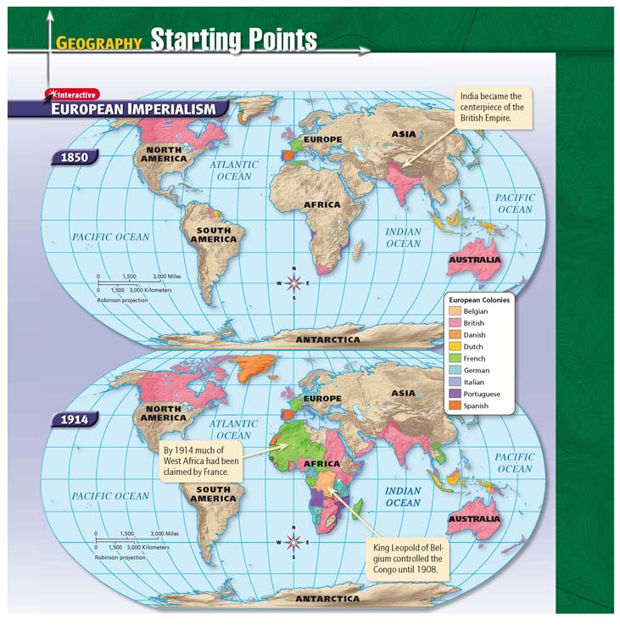

Slide 6
Types of Imperialism
Existing Colonies
  British in India
  Dutch in Indonesia
Empires in Africa
  Britain in West Africa
  Belgium in the Congo

Slide 7
Settler Colonies
  British in Australia
  French in Algeria
Economic Imperialism (Spheres of Influence)
  British in China (Opium Wars)
  United States in Latin America

Slide 8
Economic Imperialism (Spheres of Influence)
  British in China (Opium Wars)
  United States in Latin America

Slide 9
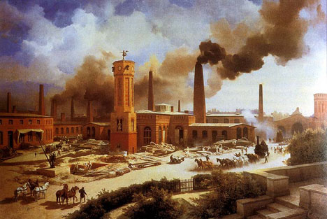
Economic Causes
Old
New
“God, Glory, Gold”
  luxury goods
  precious metals
  route to Asia
cheap raw materials to fuel Industrial Revolution
markets for finished goods
military bases
outlet for surplus population

Slide 10
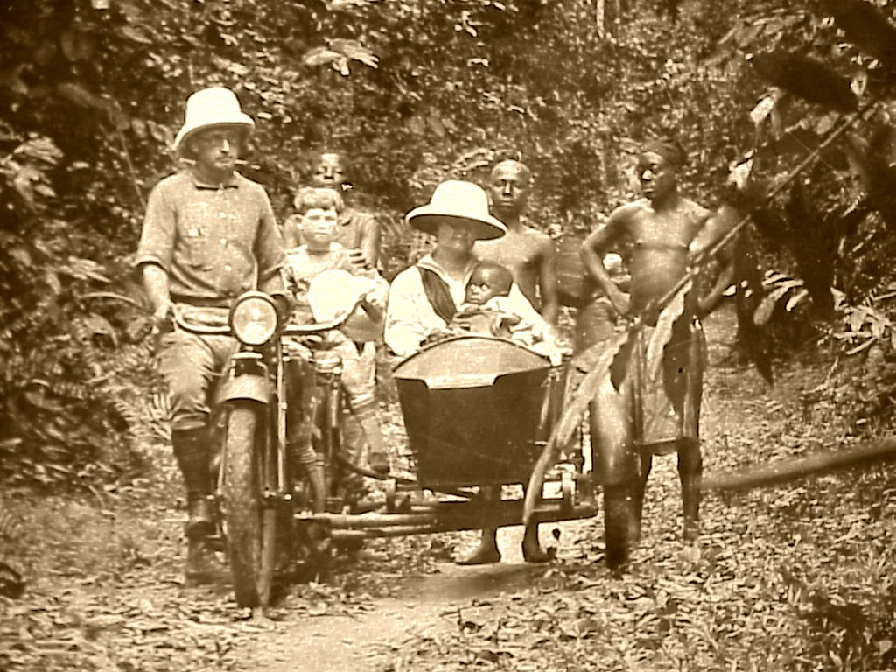
Religious Causes
Old
New
Roman Catholic missionaries
  conversion of “savages”
Protestant and Catholic missionaries
  conversion of “savages”
  end African slavery
    Christians could not enslave Christians

Slide 11
nATIONALISM
Identity and loyalty tied to state
Colonies – strategic military locations – power, pride, prestige

Slide 12
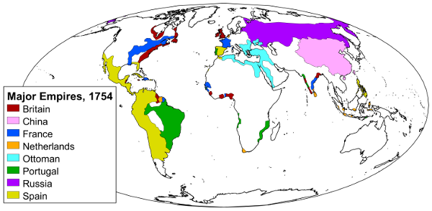
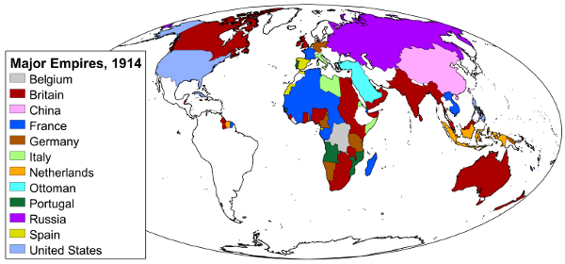
Geographic Focus
Old
New
coastal Africa
coastal Asia
Americas
  primary focus
Sub-Saharan Africa
India
China
southeast Asia

Slide 13
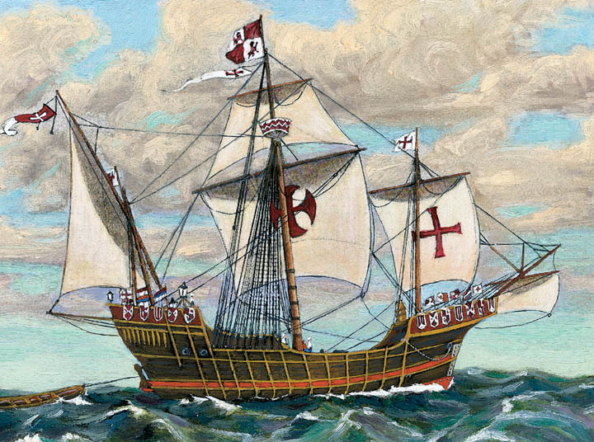
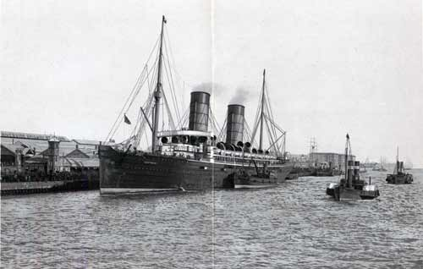
Technology
Old
New
caravels
cannon
muskets
map making
quinine vaccine
  to treat malaria
machine gun
railroad
telegraph
steamship

Slide 14
Characteristics
Old
New
aspect of exploration and Commercial Revolution
Africa and Asia
  commercial control
Americas
  land empire and settlements
aspect of Industrial Revolution
Africa and Asia
  land empires
pushed social reform and western education
Nationalism

Slide 15
Administration
Old
New
large geographic areas under single nation
profit over empire
trade monopolies
  Dutch and East India Companies
forced labor
  Spanish
smaller colonial areas
indirect rule
  Brit and India (at first)
direct rule
  paternalism and assimilation
more control from mother country
racism and segregation

Slide 16
Leading States
Old
  1500s
    Portugal and Spain
  1600s
    France, Britain, Netherlands

Slide 17
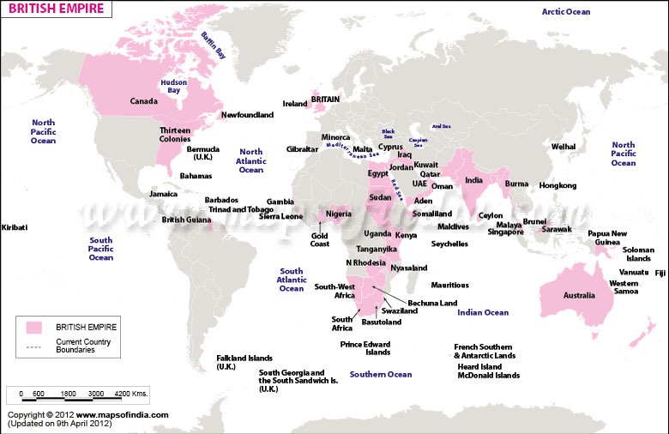
New
  British

Slide 18
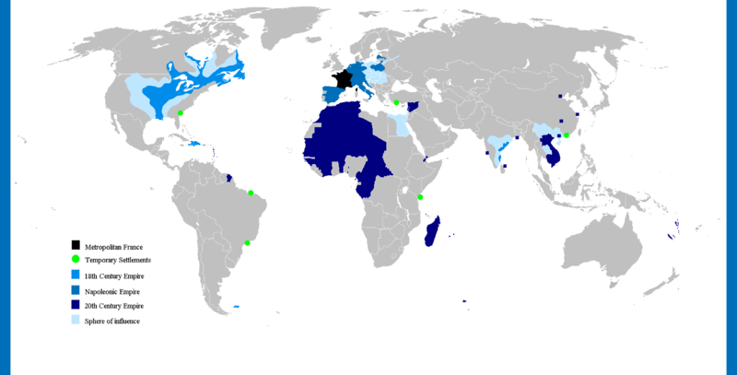
French

Slide 19
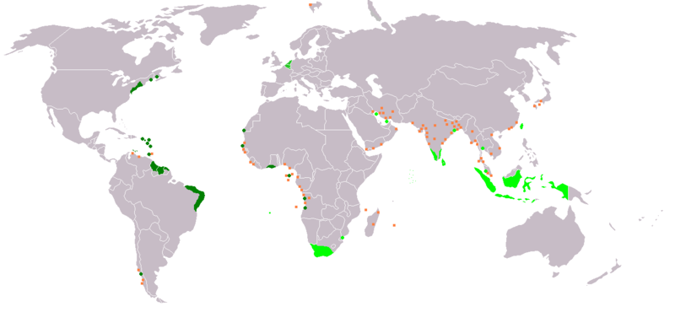
Dutch

Slide 20
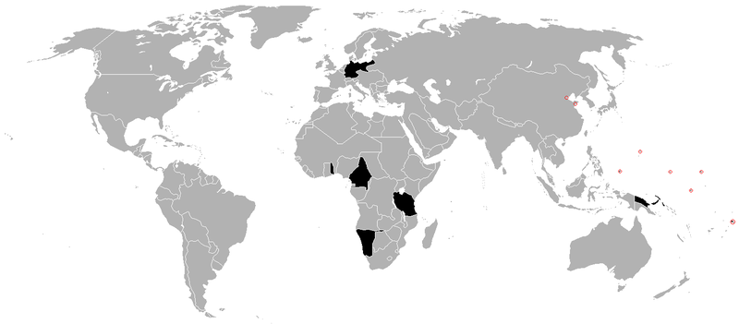
Germany

Slide 21
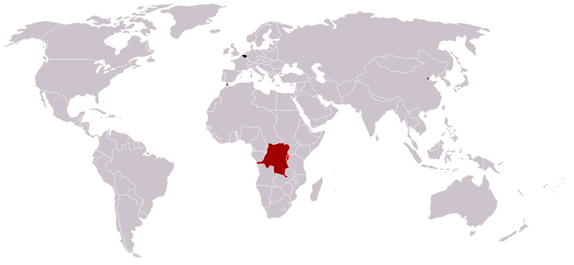
Belgium

Slide 22
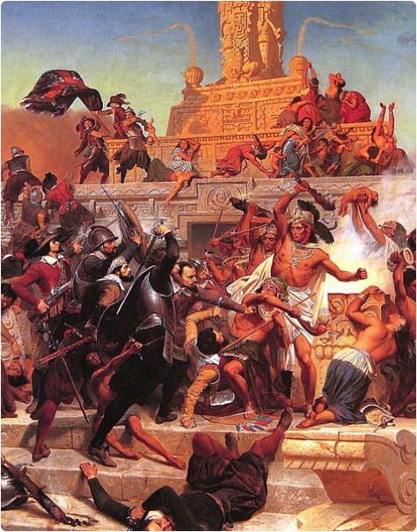
Methods of Conquest
Old
New
military conquest
concessions
spheres of influence
protectorates
colonies

Slide 23
Impact on Natives
Old
New
Negative
  catastrophic native deaths
  loss of traditions
Positive
  Columbian Exchange of food items and livestock
Negative
  death from war and disease
  economic exploitation
  political divisions
  loss of traditions
Positive
  reduced local warfare
  modernization
  higher standard of living

Slide 25
Similarities
political control shaped by elites
colonial authority legitimized by claims of progress and order
exports allowed colonies to be integrated into the world economy
sharp social/racial divisions developed

Slide 26
paternalist colonial culture based on race
gender divisions of labor
exploitation
administration, legal and educational precedents are still in place
European population concentrated in urban areas or provincial towns

