Slide 1
The renaissance

Slide 2
Introduction

Slide 3
“rebirth” of art and learning (1300-1650 CE)
began w/ wealth from trade
financed by powerful families (Medici)
centered in Italy

Slide 4
Characteristics

Slide 5
Greek and/or Roman Influence
came to them from Ottoman Empire
artists
attempted to match the styles of classical artists
idealized version of the human form
realism
architects
studied classical ruins

Slide 6
Humanism
secular humanism
secular
Dealing with non-religious
humanism
placing human nature at the center of interests

Slide 7
Emphasis on the Individual
celebrating individuals for their achievements
“Renaissance Man”

Slide 8
Celebration of Secular Achievements
Things that occurred in this world

Slide 9
Art/Architecture Analysis

Slide 10
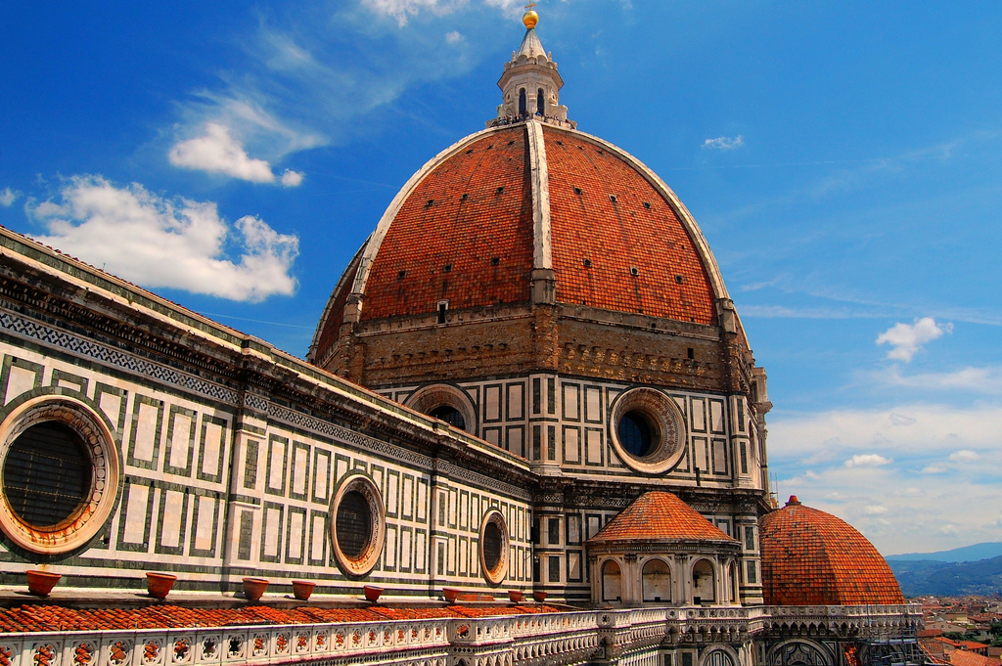
Brunelleschi’s Dome

Slide 11
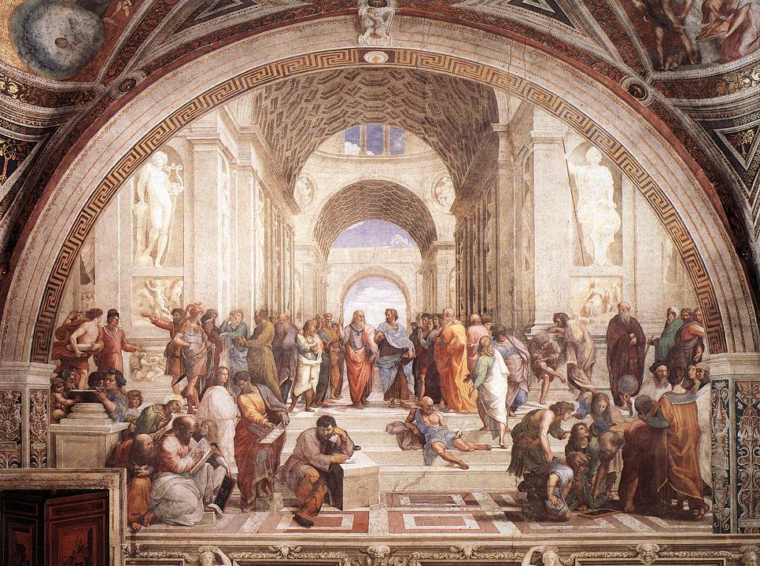
The School of Athens

Slide 12
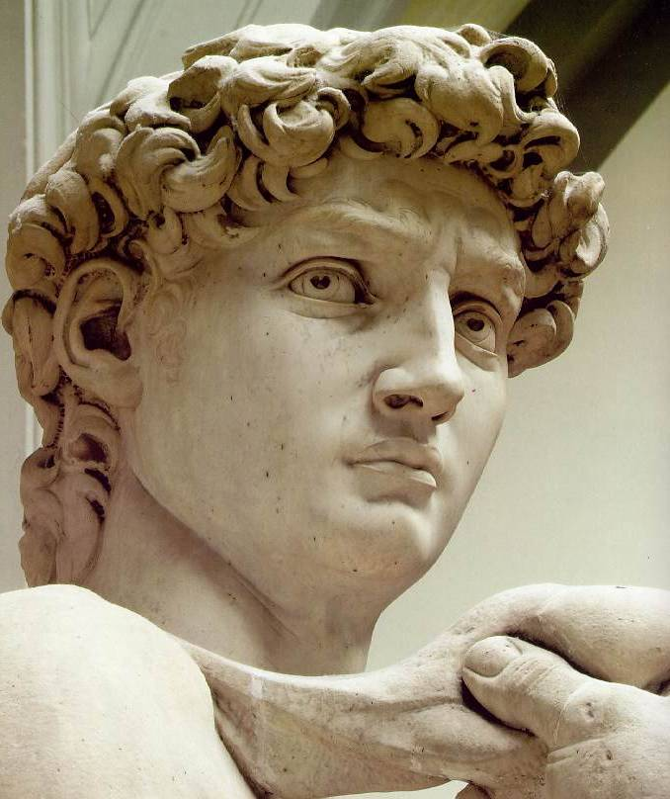
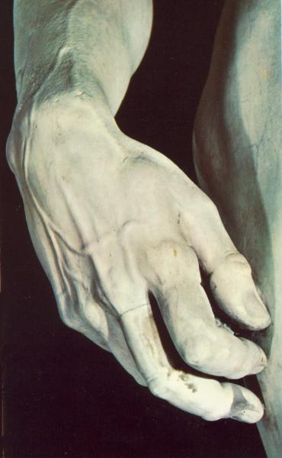
David (Michelangelo)

Slide 13
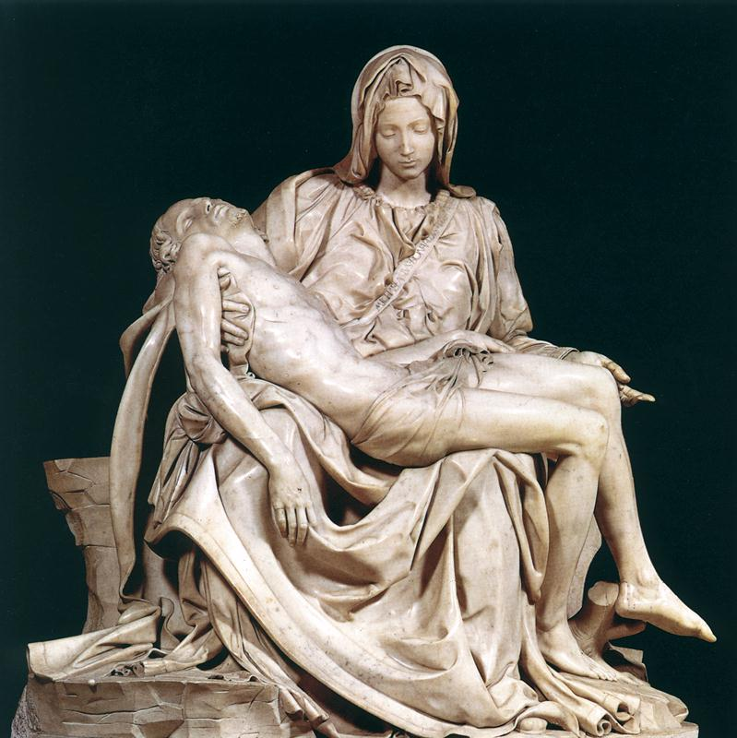
The Pieta (Michelangelo)

Slide 14
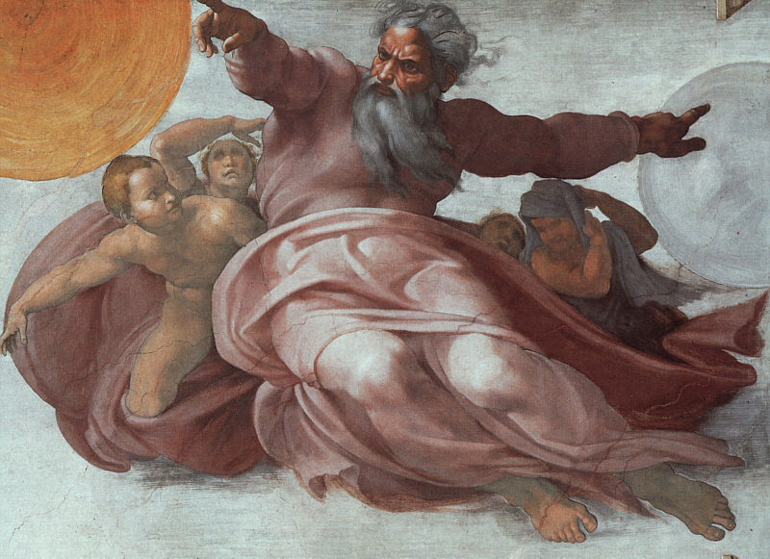
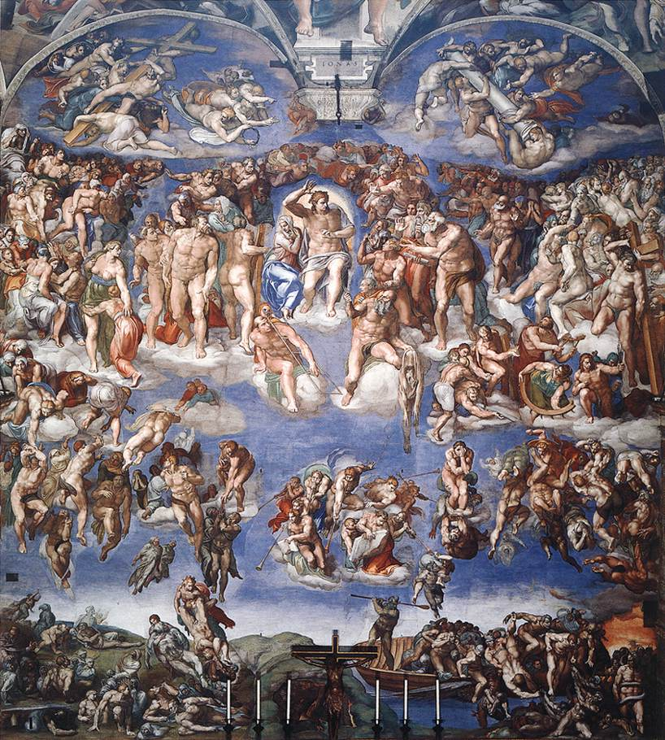
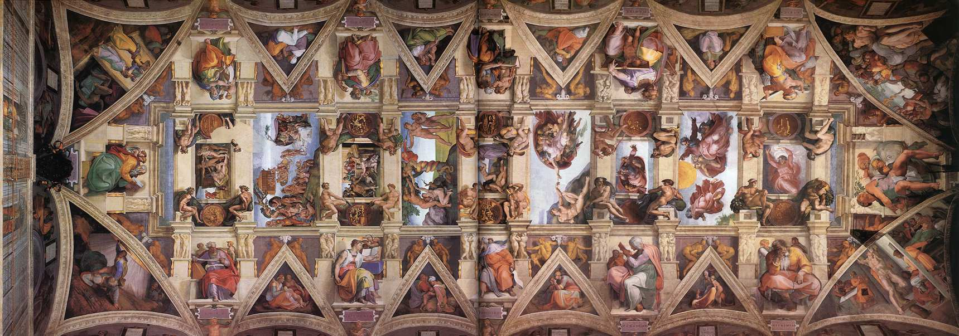
The Sistine Chapel (Michelangelo)

Slide 15
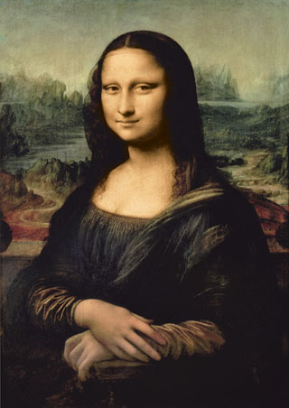
Mona Lisa (da Vinci)

Slide 16
The Last Supper (da Vinci)

Slide 17
The Northern Renaissance

Slide 18
How did the Renaissance spread?
students returning from Italy
commerce/universities
printing press

Slide 19
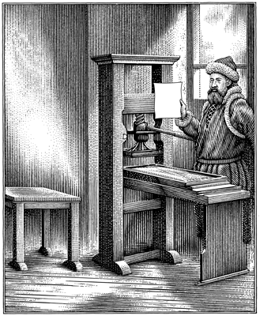
Spread of Ideas
Printing press
Johannes Gutenberg- 1450

Slide 20
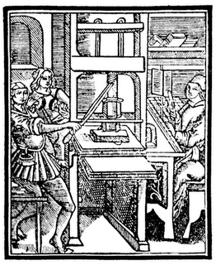
Problems
durability of paper books
plainness of mass production
threats to scribes

Slide 21
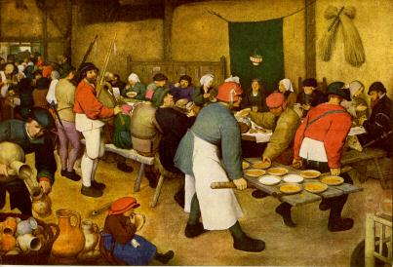
A Peasant’s Wedding (Brueghal)

Slide 22
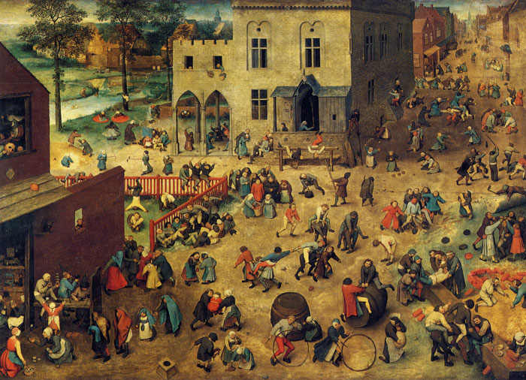

Slide 23
Italian/Northern Comparison
Italian
humans based on models of Greek and Roman art
rippling muscles/ ideal image
Northern
more like normal people
bald, frail, imperfect

