Slide 1
Maps: Land Empires

Slide 2
Ottoman Empire

Slide 4
Safavid Empire

Slide 6
Mughal Empire

Slide 8
Qing Dynasty

Slide 10
Songhai Empire

Slide 12
Tokugawa Shogunate

Slide 13
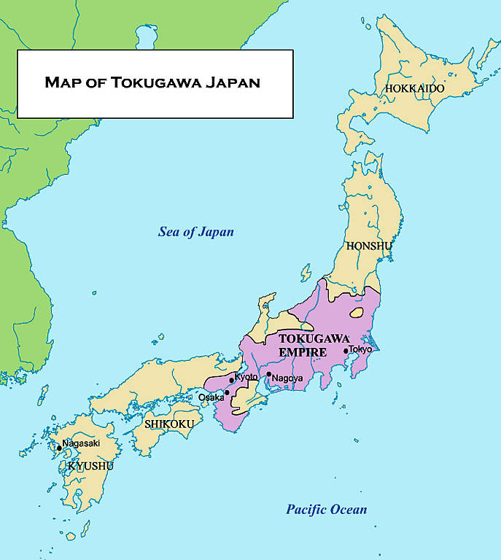

Slide 14
Russian Empire

