Slide 1
The Protestant Reformation

Slide 2
What is the Protestant Reformation?
Protestant Reformation- a religious movement in the 1500’s that split the Christian church in western Europe and led to the establishment of a number of new churches.
People grew displeased with the churches…
Financial Corruption
Abuse of Power
Immorality

Slide 3
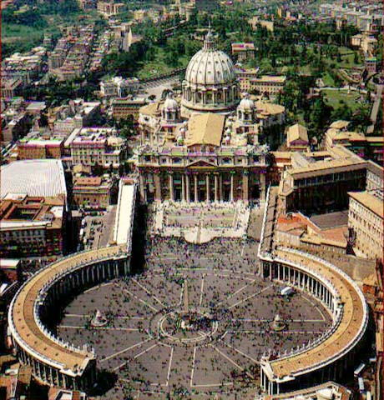
Immediate Cause of the Reformation
Pope Leo X needs money to build St. Peter’s Basilica…so he sells indulgences
Indulgences- were pardons issued by the pope that people could buy to reduce a soul’s time in purgatory = (People could buy forgiveness)

Slide 4
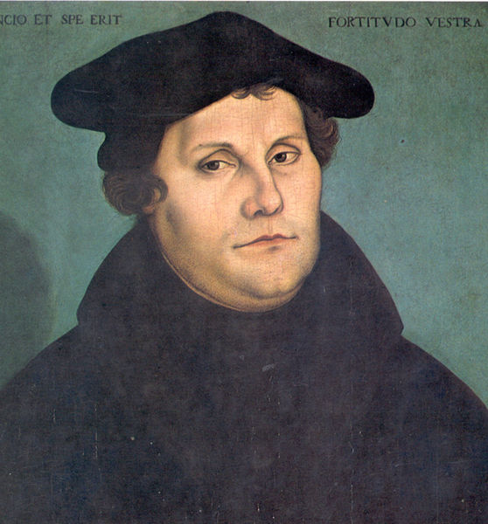
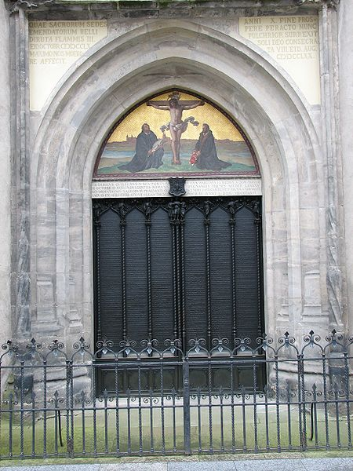
Martin Luther
Luther was a German monk and professor of theology (religion) at the University of Wittenberg.
Notes:
Luther translates the Bible to German and believes that people should be able to interpret the Bible for themselves.
Coffer means chest

Slide 5
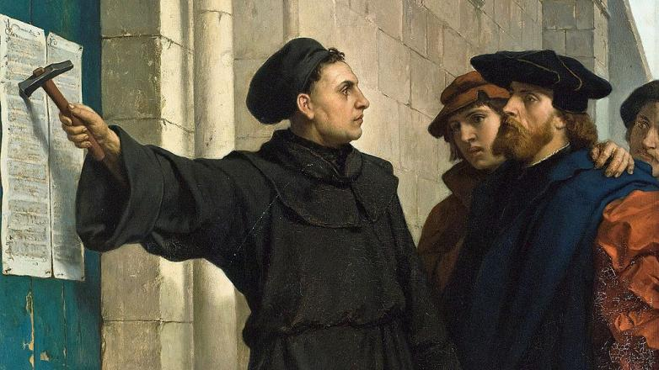
Luther’s 95 Theses
In 1517, the 95 Theses were nailed to a church door. They were written in Latin.
Criticized:
Indulgences
Power of Pope
Wealth of Church
God’s Grace won by faith alone
Catholic View: Good Works

Slide 6
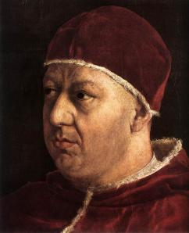
Catholic Response
In 1520 Pope Leo X excommunicated Luther.
Excommunication- expelled him from the church.
Holy Roman Emperor Charles V passed measures to suppress Luther’s writings.
Lutheran princes in Germany issued a protestation or protest.
Hence the term Protestant
Notes:
Pope Leo X by Raphel

Slide 7
Important Developments that aid the process to Reformation
The Printing Press
Books are now available to the masses not just the rich! (Faster production=cheaper books)
People have access to books whenever they want them.
Notes:
Like the Kindle or Nook to early modern Europeans.
A single Renaissance printing press could produce 3,600 pages per workday, compared to forty by hand-printing and a few by hand-copying.

Slide 8
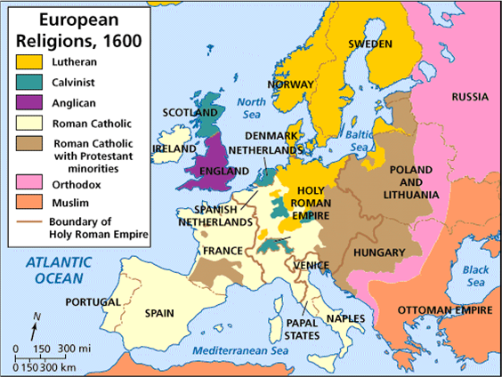

Slide 9
The Catholic Reformation

Slide 10
three pronged strategy to counter the Protestant Reformation and expand Catholicism

Slide 11
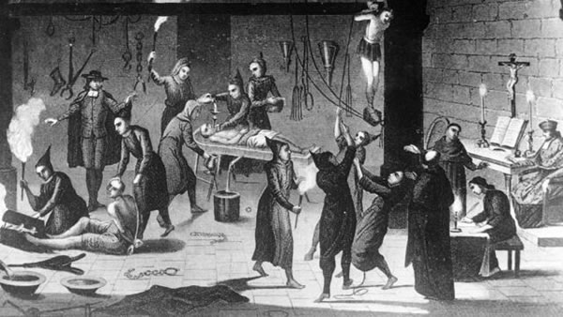
The Inquisition
attempt to discover and punish nonbelievers (Protestants)

Slide 12
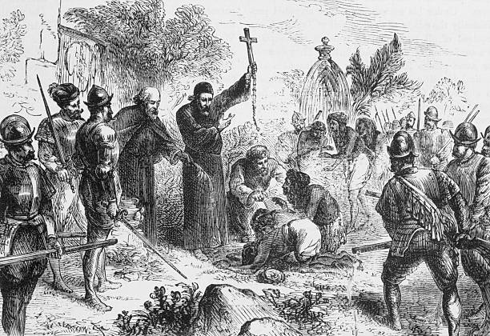
Jesuits (1540)
religious order founded by Ignatius of Loyola
missionary activity, particularly in New World

Slide 13
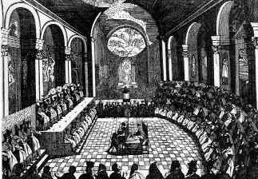
Council of Trent
corrected some abuses
reaffirmed some rituals
Index of Prohibited Books
writings dangerous to faith

Slide 14
Results of Catholic Reformation
Catholicism remained dominant in the Mediterranean region
Spanish, Portuguese, French colonies were established as Catholic

