Slide 1
Topic 4.6: Changing Social Hierarchies

Slide 2
A. Many states adopted practices to accommodate the ethnic and religious diversity of their subjects.

Slide 3
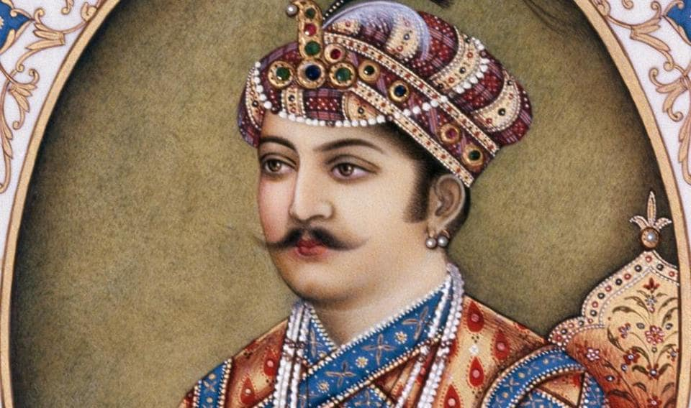
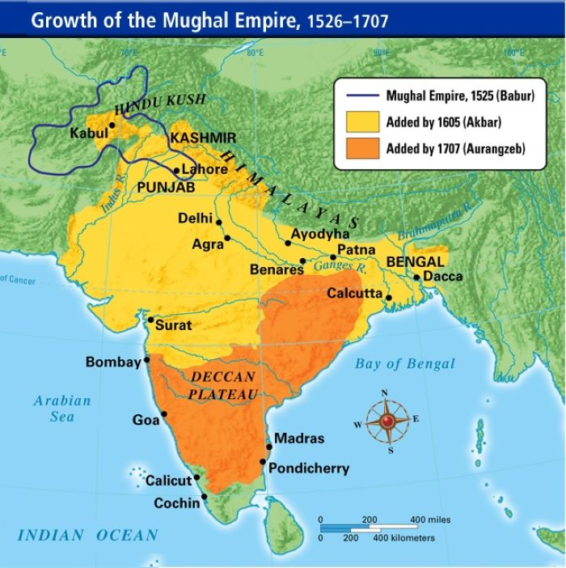
Akbar (Mughal Empire)

Slide 4
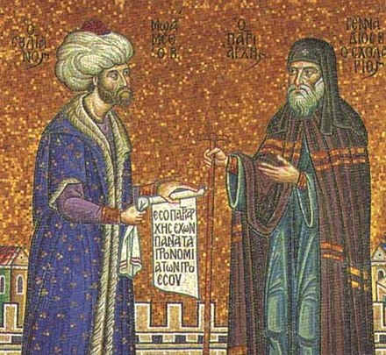
Millet System (Ottoman)

Slide 5
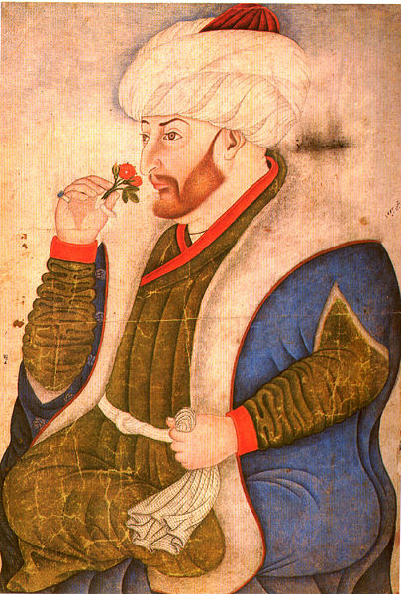
Mehmed II (Ottoman)
Partially accepted Jews from Spain
Allowed to worship
Could not live where they wanted
Could not hold top gov’t positions

Slide 6
B. Many states utilized the economic, political, and military contributions of different ethnic or religious groups.

Slide 7
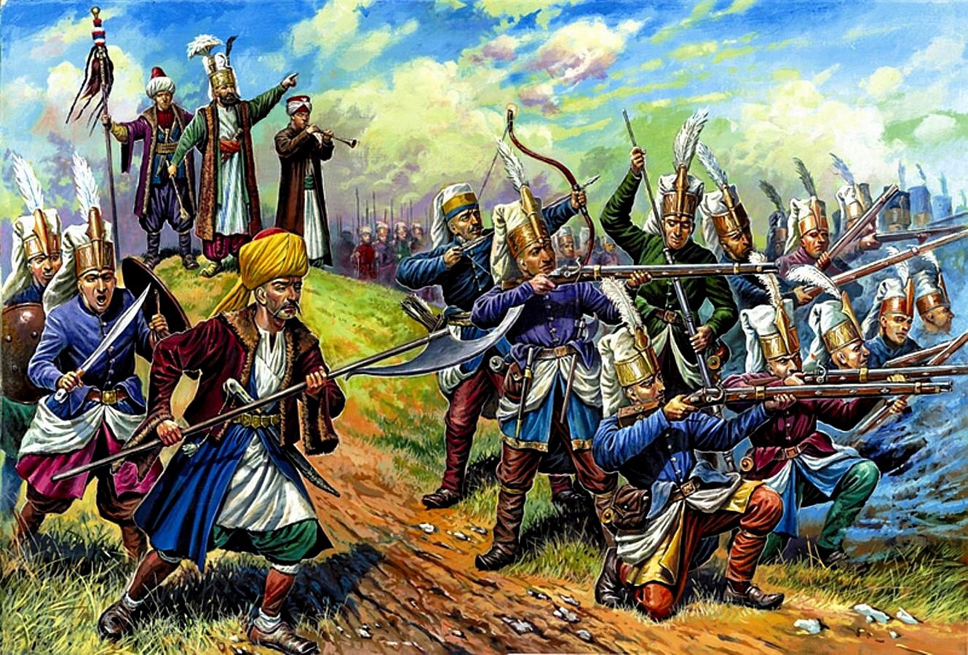
Janissaries

Slide 8
C. Some states suppressed diversity or limited certain groups in society, politics, or the economy.

Slide 9
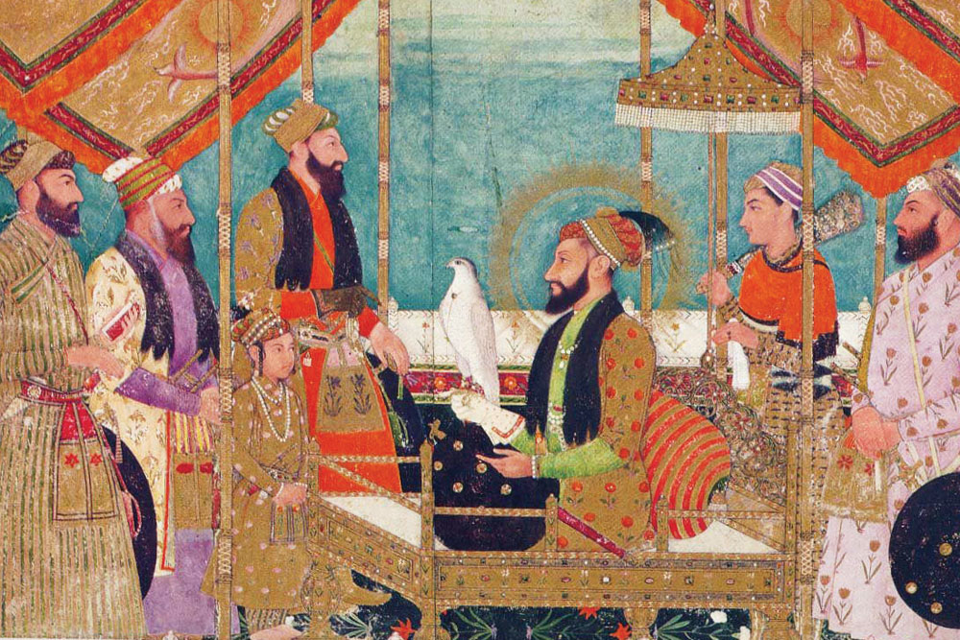
Aurangzeb

Slide 10
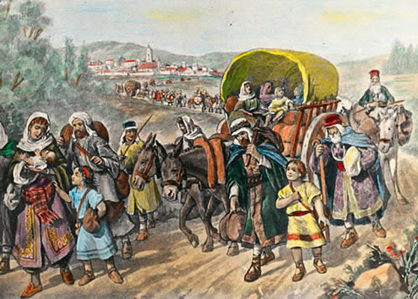
Expulsion of Jews from Spain
Begins with Inquisition
Convert or leave

Slide 11
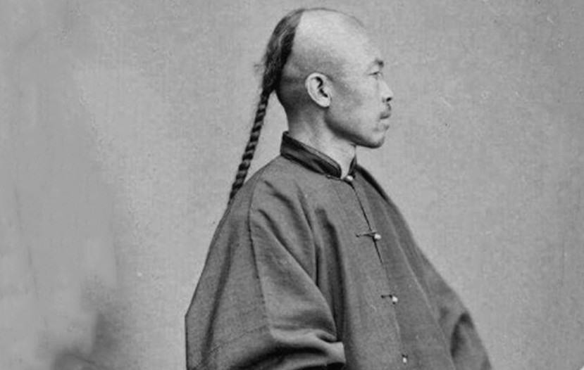
Qing Restrictions on Han
“queue” hairstyle
Eight Banner System
Distinguished Manchu elites from commoners
Political and economic privileges

Slide 12
D. Imperial conquests and widening global economic opportunities contributed to the formation of new political and economic elites.

Slide 13
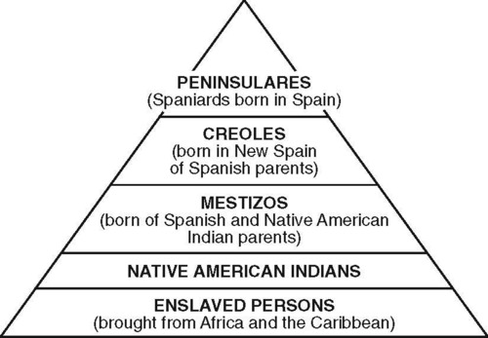
Casta System

Slide 14
E. The power of existing political and economic elites fluctuated as the elites confronted new challenges to their ability to affect policies of the increasingly powerful monarchs and leaders.

Slide 15
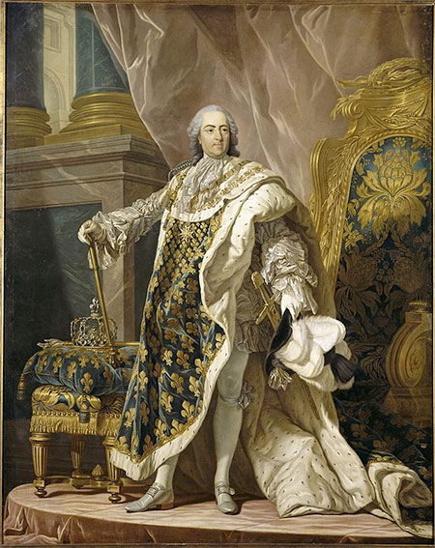
Absolutism

Slide 16
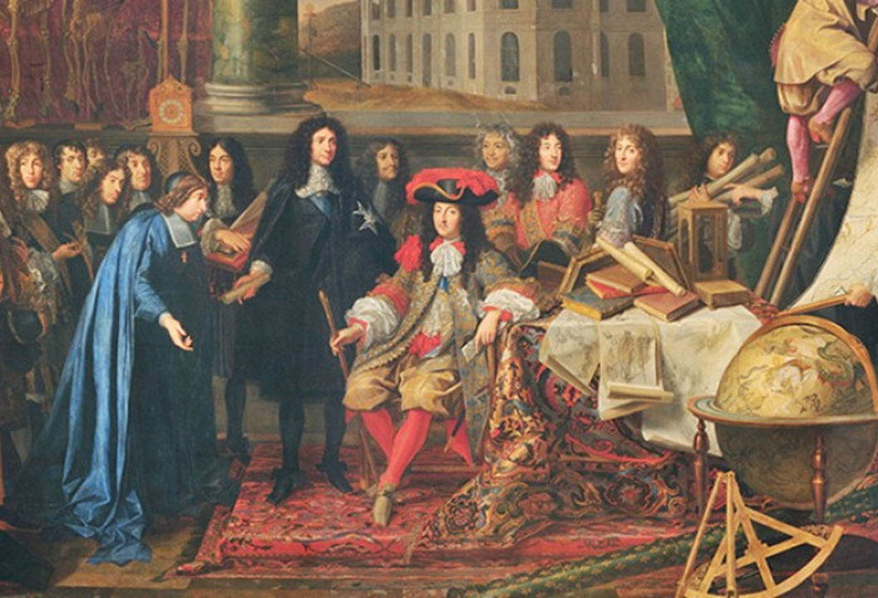
European Nobility
Medieval Era
Wealth and power from land
Early Modern Era
Commercial Revolution

Slide 17
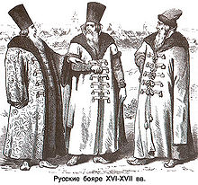
Russian Boyars
Ivan III, IV attempt to weaken power
Deportations, executions

