Slide 1
Topic 5.3: Causes of the Industrial REvolution

Slide 2
Learning Objective 1:
Explain how environmental and other factors contributed to industrialization from 1750-1900.

Slide 3
A. A variety of factors contributed to the growth of industrial production and eventually resulted in the Industrial Revolution.

Slide 4
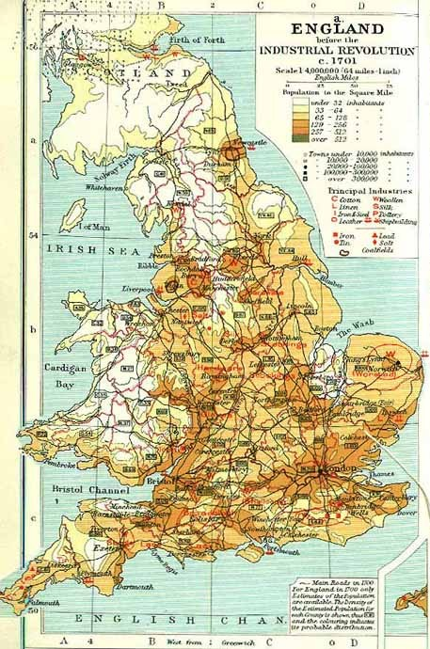
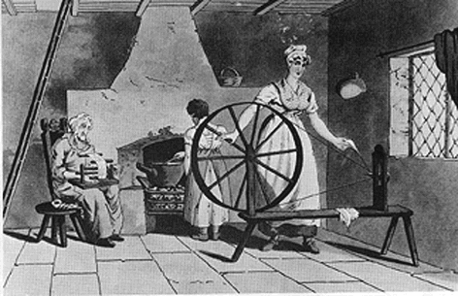
Pre-Industrial England (Context)
Mainly rural
Cottage industries

Slide 5
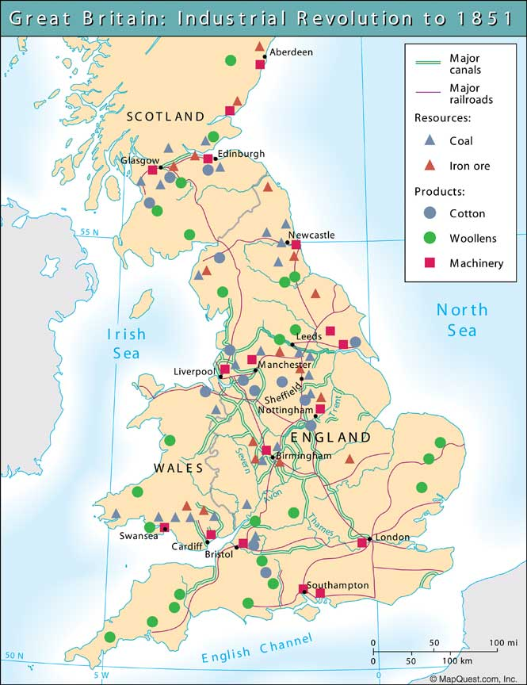
Environmental Causes
Mineral resources
Rivers

Slide 6
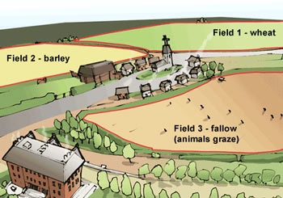
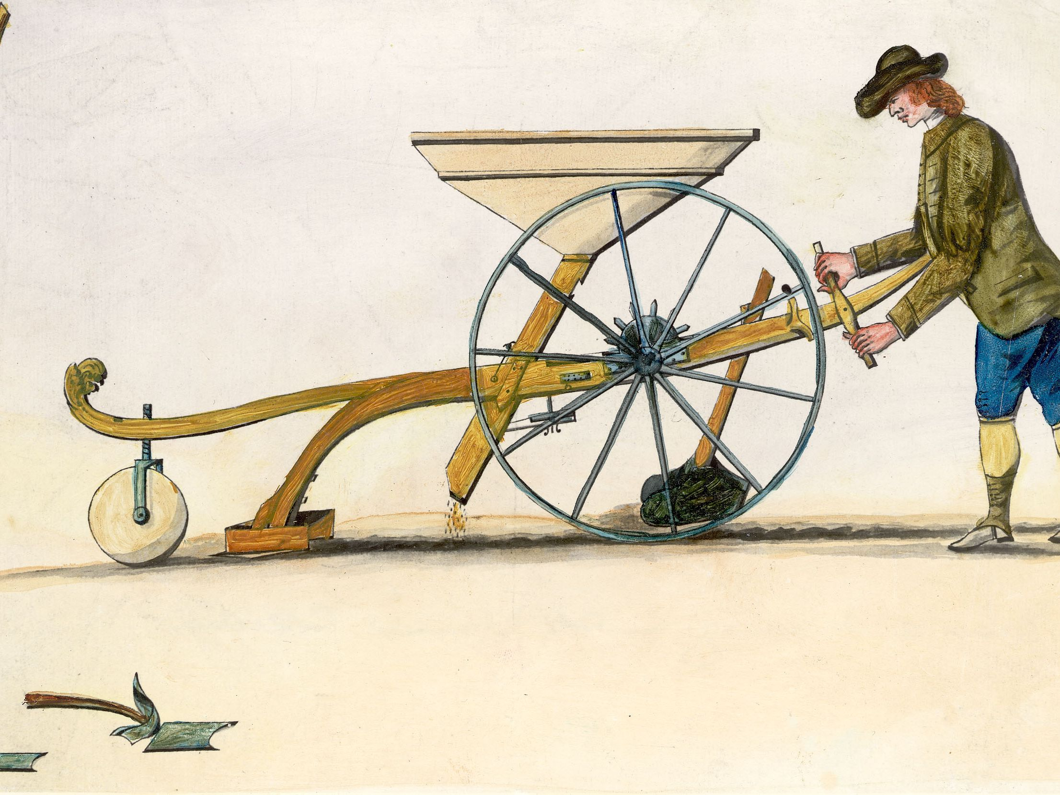
Agricultural Causes
Agricultural Revolution
Crop rotation
Seed drill (Jethro Tull)

Slide 7
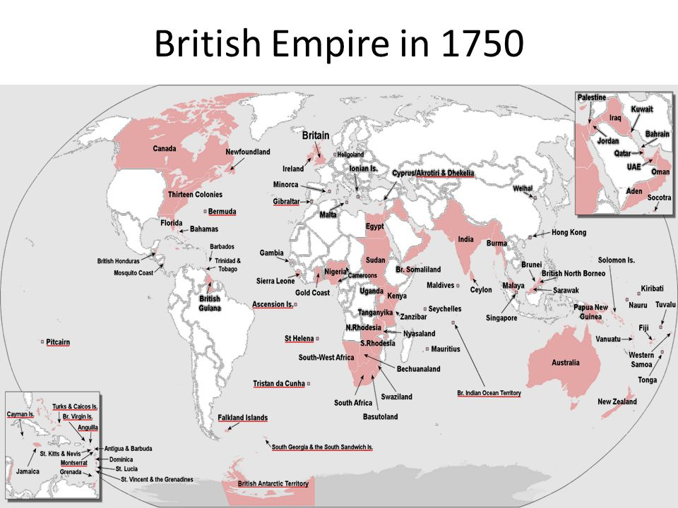
Economic Causes
New colonies led to accumulation of private capital

Slide 8
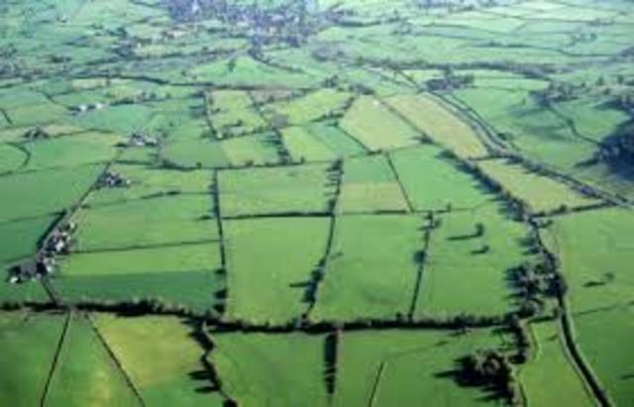
Urbanization
Population growth
Enclosure Movement

Slide 9
Technology and Transportation
Topic 5.4

Slide 10
B. The development of the factory system concentrated production in a single location and led to an increasing degree of specialization of labor.

Slide 11
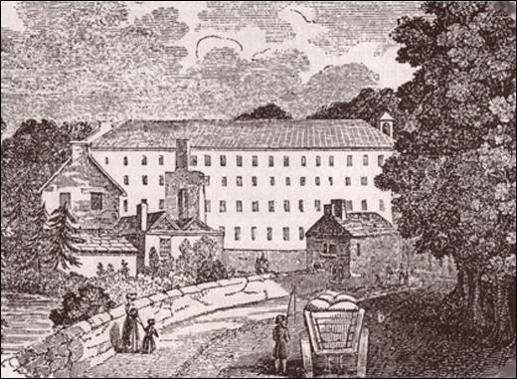
Richard Arkwright
Weaving machines in central location
Located on water source

Slide 12
Topic 5.4: Technology of the industrial age

Slide 13
Learning Objective 1:
Explain how technology shaped economic production over time.

Slide 14
A. The development of machines made it possible to take advantage of both existing and new discovered resources of energy stored in fossil fuels.

Slide 15
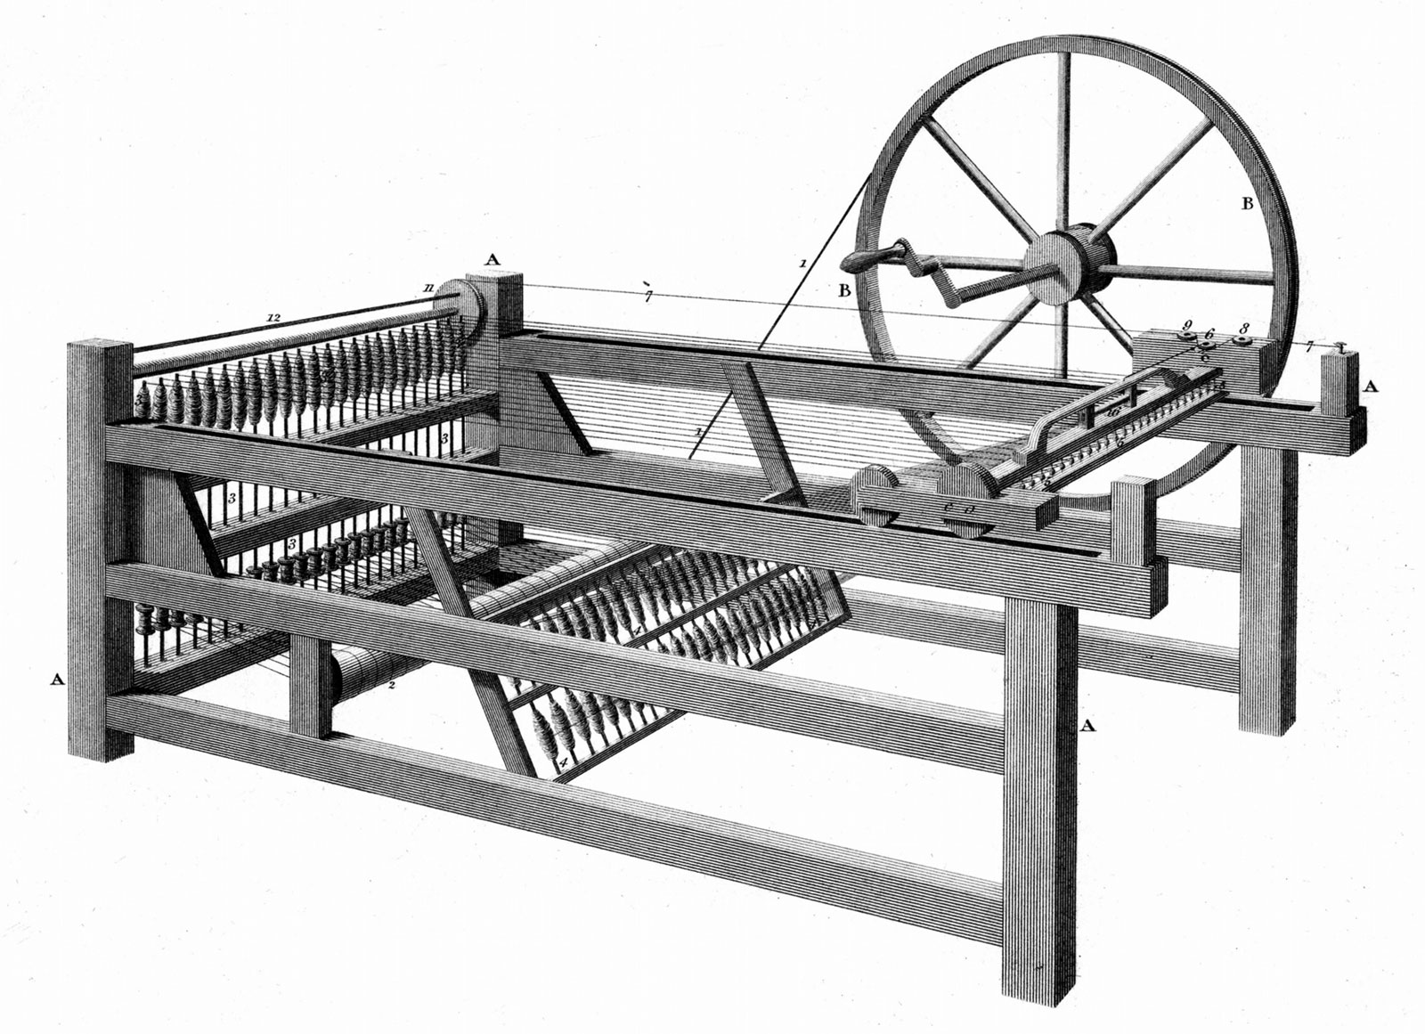
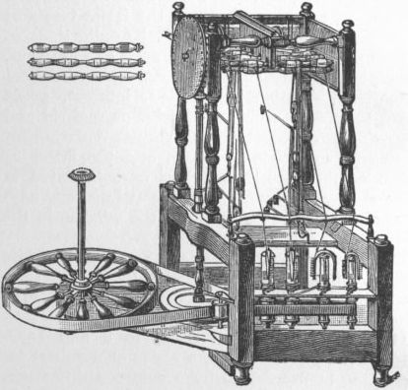
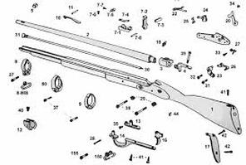
Early Machines
Spinning jenny (James Hargreaves)
Water frame
Interchangeable parts

Slide 16
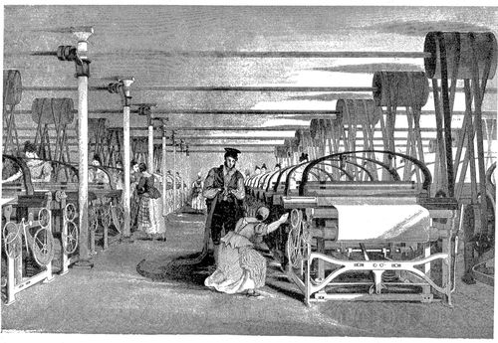
Effects of Machines
Division/specialization of labor
Rise of unskilled labor

Slide 17
B. The “Second Industrial Revolution” led to new methods in the production of steel, chemicals, electricity, and precision machinery during the second half of the 19th century.

Slide 18
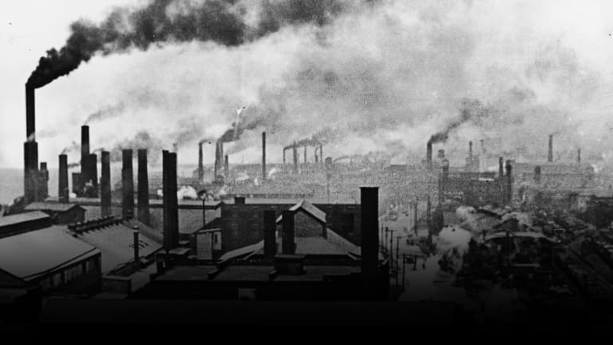
Second Industrial Revolution
Shift from textiles to industrial goods

Slide 19
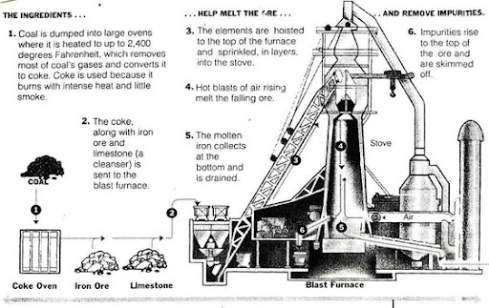
Steel
Bessemer Process

Slide 20
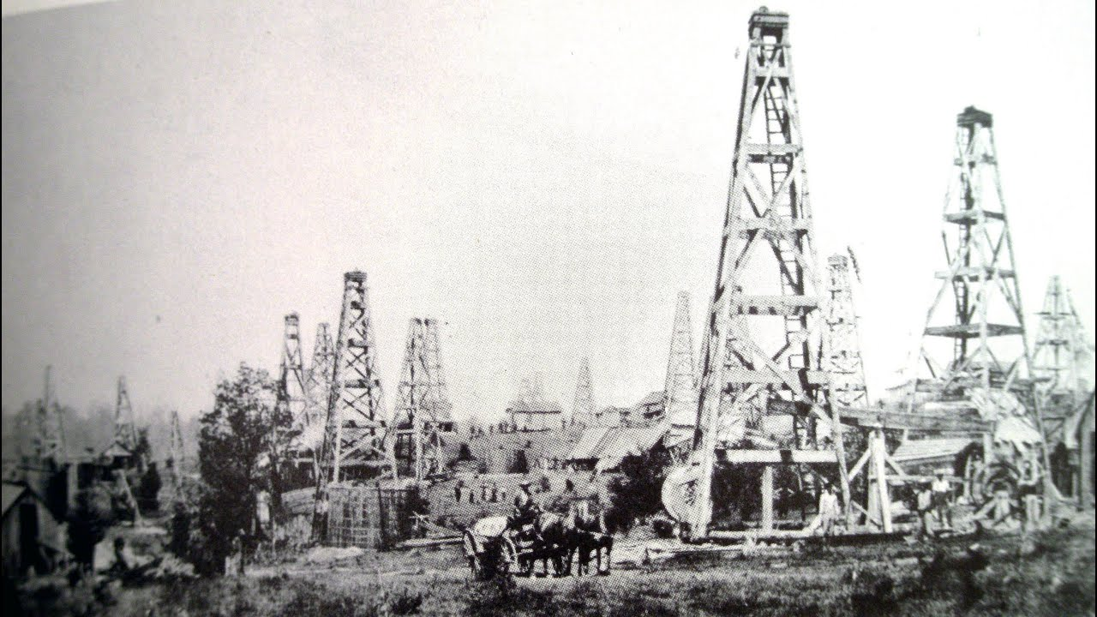
Oil
Starts with kerosene for heat, light
Leads to engines for transport

Slide 21
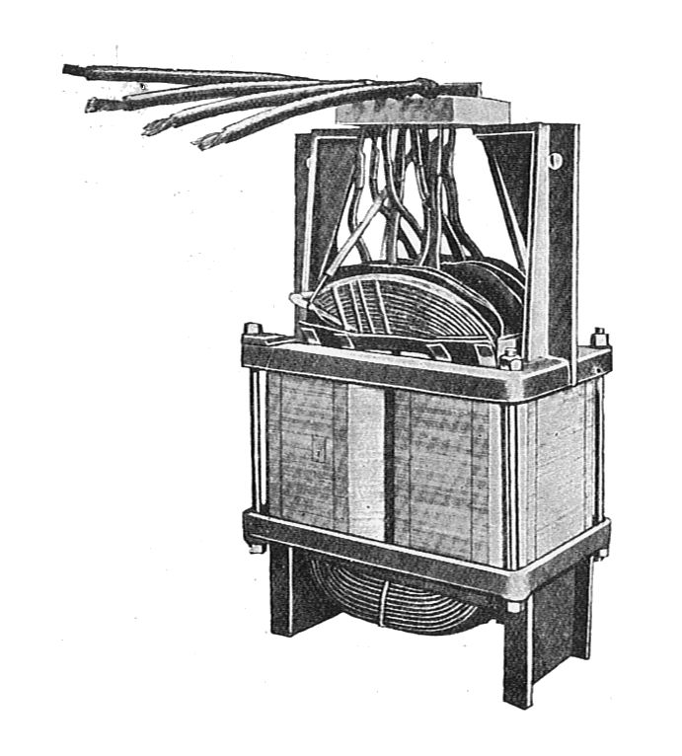
Electricity
Thomas Edison – light bulb
George Westinghouse - transformer

Slide 22
C. Railroads, steamships, and the telegraph led to increased trade and migration.

Slide 23
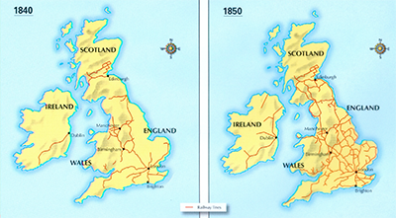
Railroads

Slide 24
Communication
Samuel Morse – telegraph
Alexander Graham Bell – telephone
Guglielmo Marconi - radio

